Slide 1
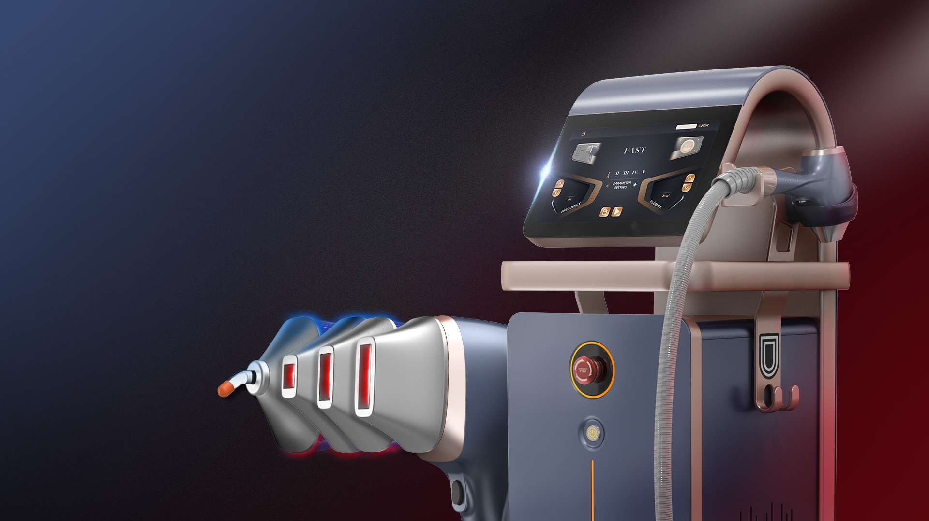
HIDL-1800W (755nm+808nm+1064)
Super High Power Diode Laser Hair Removal Machine
Gold Standard working energy- 10J + 5ms
Super short pulse duration Super long life span Super high power

Slide 2
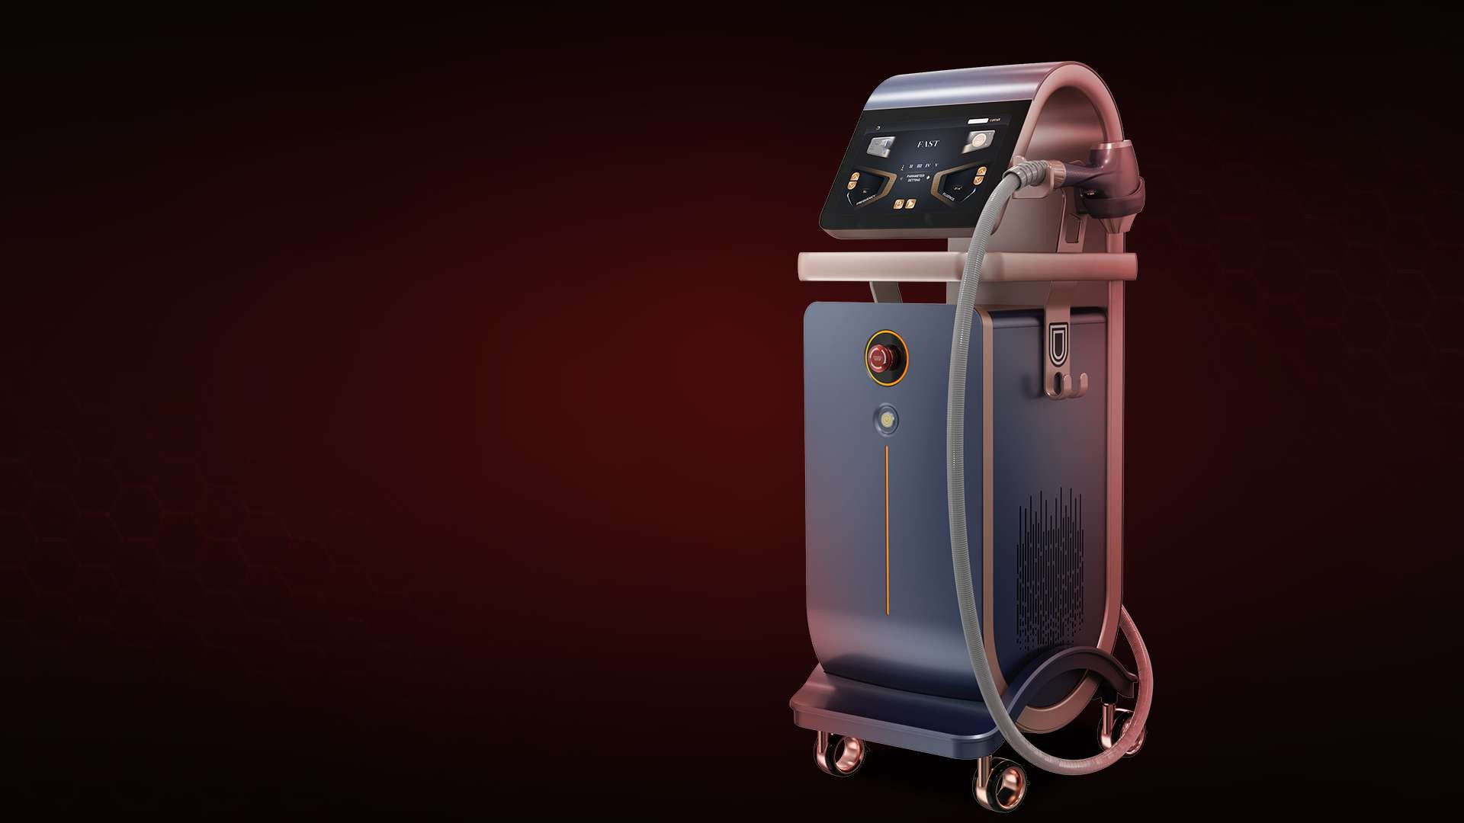







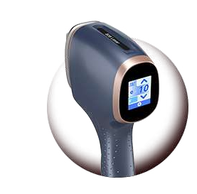

Product Display
Front View
Handpiece With Touch Screen
12inch Big Screen
Holder
Emergency Button
Switch Button
High-End Hollow Silent Wheel

Slide 3
















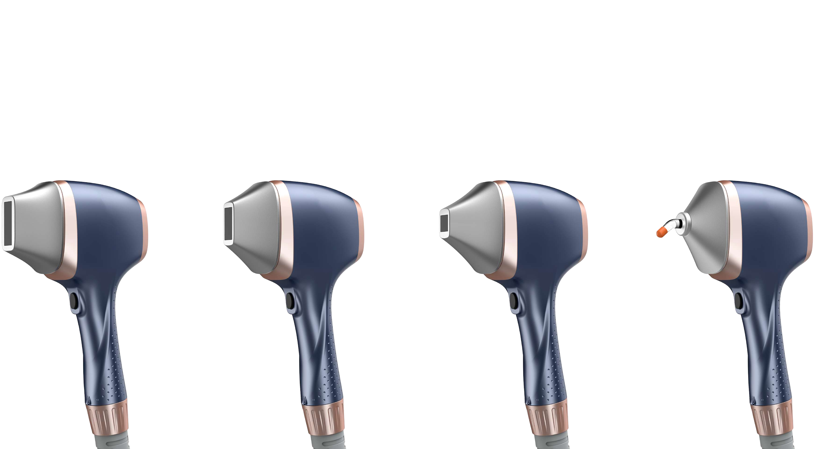
Treatment Head Advantage
Different spot sizes head working on one handle. More Choices for different body area.
38.5mm
28.5mm
14.5mm
5mm
13.5mm
13.5mm
12.5mm
8.25mm

Slide 4
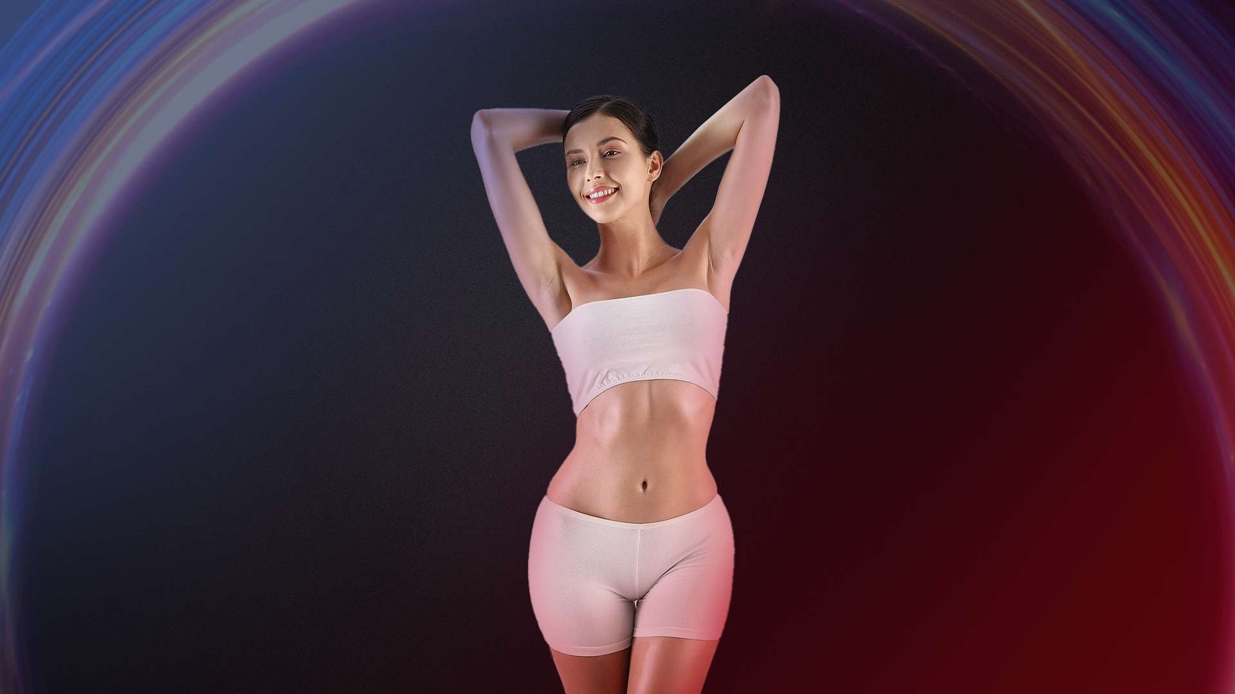










Treatment Site
Forehead:
12.5*14.5mm
Face:
12.5*14.5mm or Round 8.25mm
Nose Hair: Round 8.25mm
Mustache:12.5*14.5mm
Arm:
13.5*28.5mm
Armpit:
12.5*14.5mm
Chest:
13.5*38.5mm
Back:
13.5*38.5mm
Bikini Line:
12.5*14.5mm
Leg:
13.5*28.5mm

Slide 5
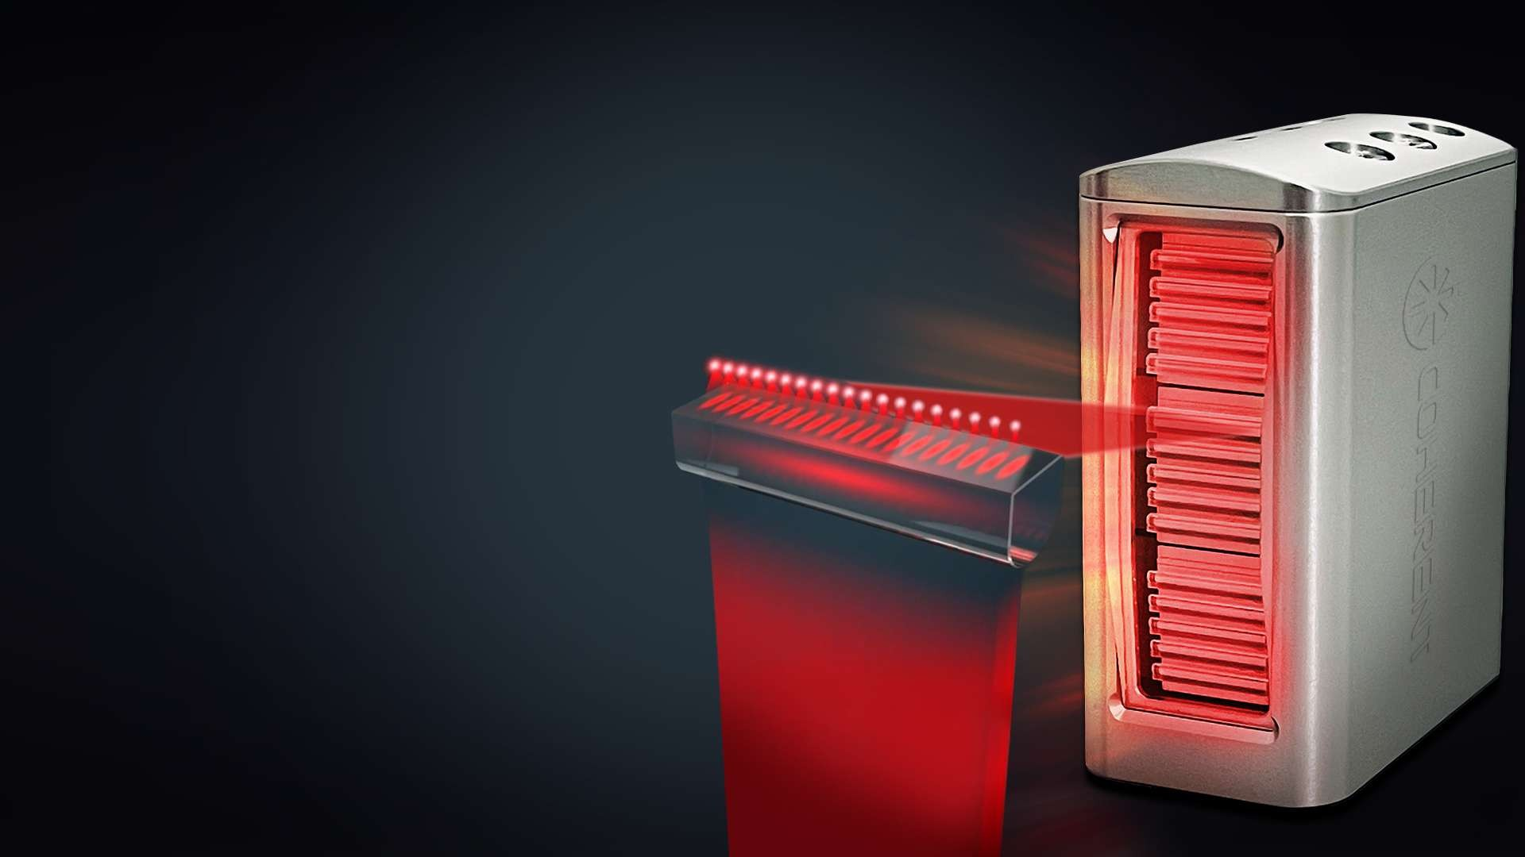






































FAC Technology Fast Axis Collimator
C imator Lens Focus Beam
Collimate the light path, reduce the divergence angle of the beam, and turn the divergent light path into a parallel light path. Smoother the edges of the laser beam.
ol
l

Slide 6
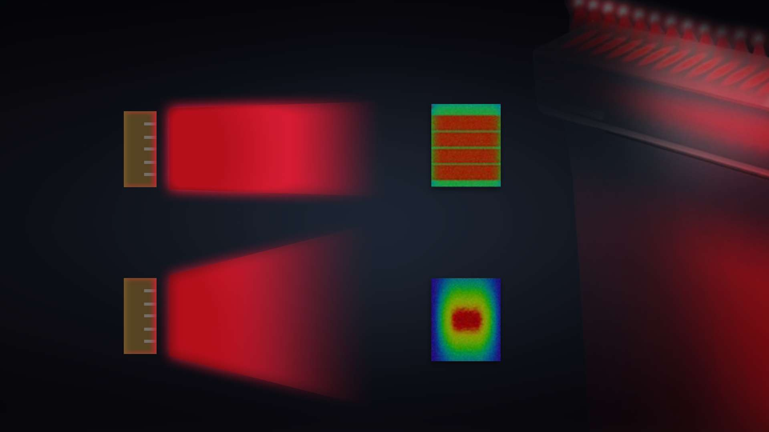





FAC Technology Fast Axis Collimator
After addition of a collimator lens, beam focus
Without optical shaping, the beam diverges rapidly

Slide 7
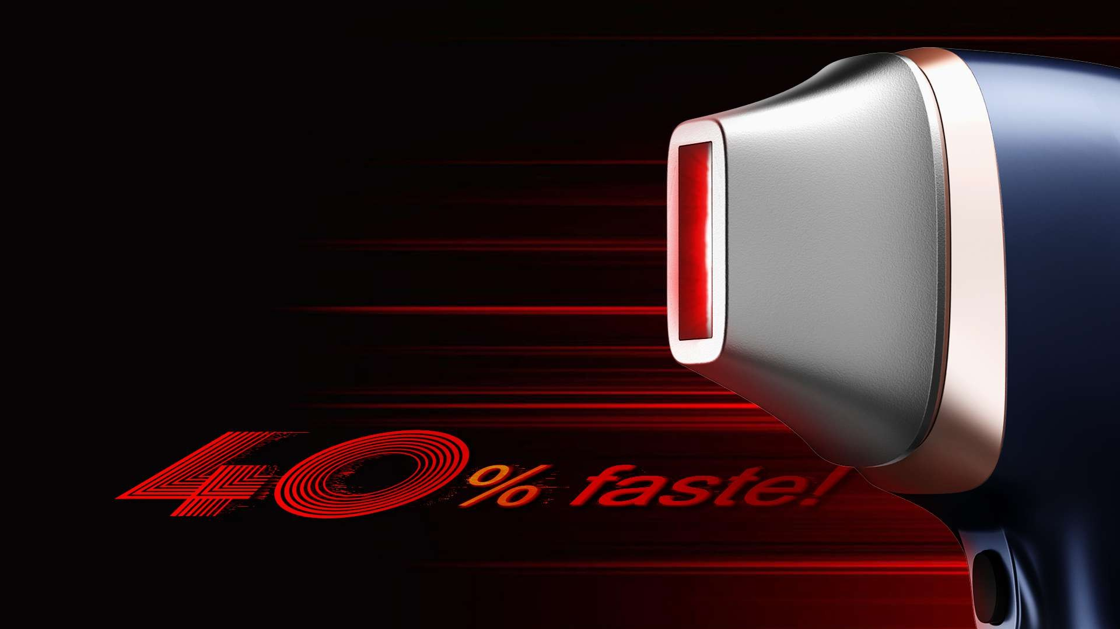























Super Large Spot Size:
Large Spot
5.2cm² 13.5*38.5mm
A unique and efficient new applicator with an especially large spot size of 4.8 cm². This breakthrough applicator makes treatments much faster and pain free, significantly cutting treatment times and ensuring a more comfortable experience for patients.

Slide 8
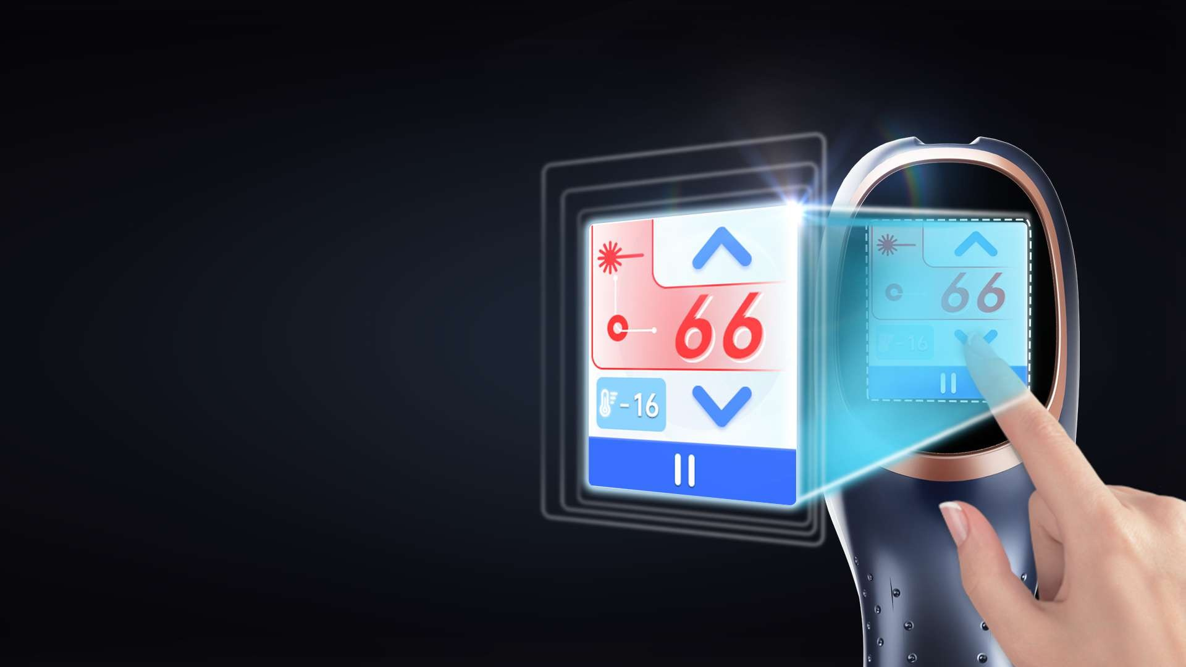
























Handle Screen
LCD Touch Screen
Energy Adjustment
Pulse Width Adjustment
Frequency Adjustment
Real-time Temperature Monitoring

Slide 9
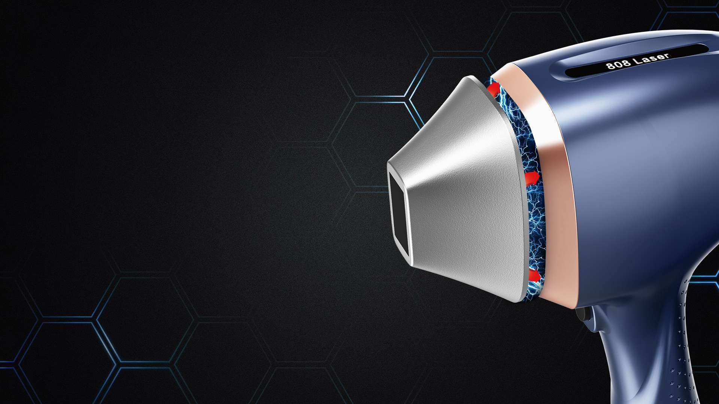































Magnetic Heads
Magnetic Heads, Strong And Safe.
The magnetic connection is strong enough to resist most unintended disconnects, making sure the treatment is safe and perfect going.

Slide 10









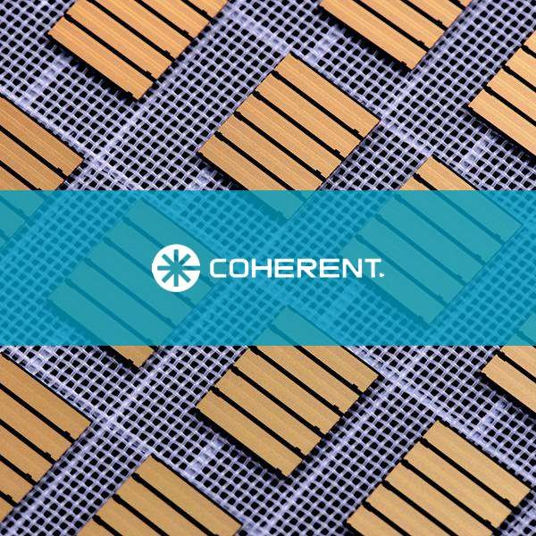

















American Original
American Origin mport
By Original American Coherent laser technology, the original bars are adopted in the laser generator to ensure that the output is stable and sufficient. The high quality bars guarantee a super zlong life span of the laser.
al
I

Slide 11













Water Proof
Best water proof Res ts
ul

Slide 12
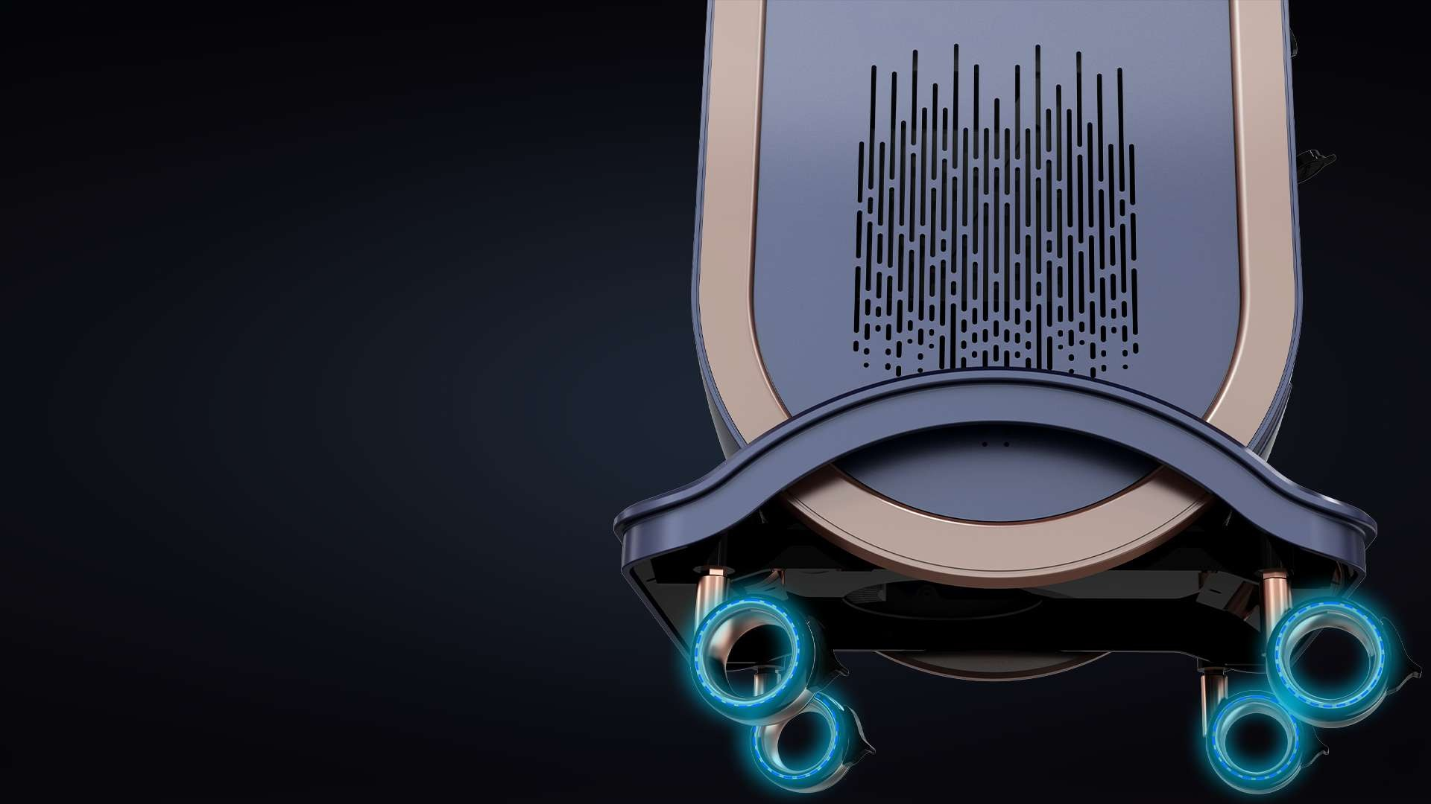































Silent Wheel
High-End Hollow Silent Wheel

Slide 13
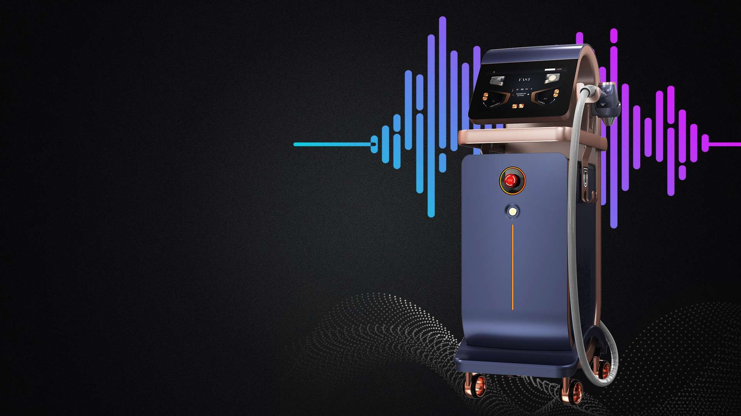

















Low Noise
Say “NO” To Noise!
Silent working, make a more silent and convenient working environment for clients and operators.

Slide 14
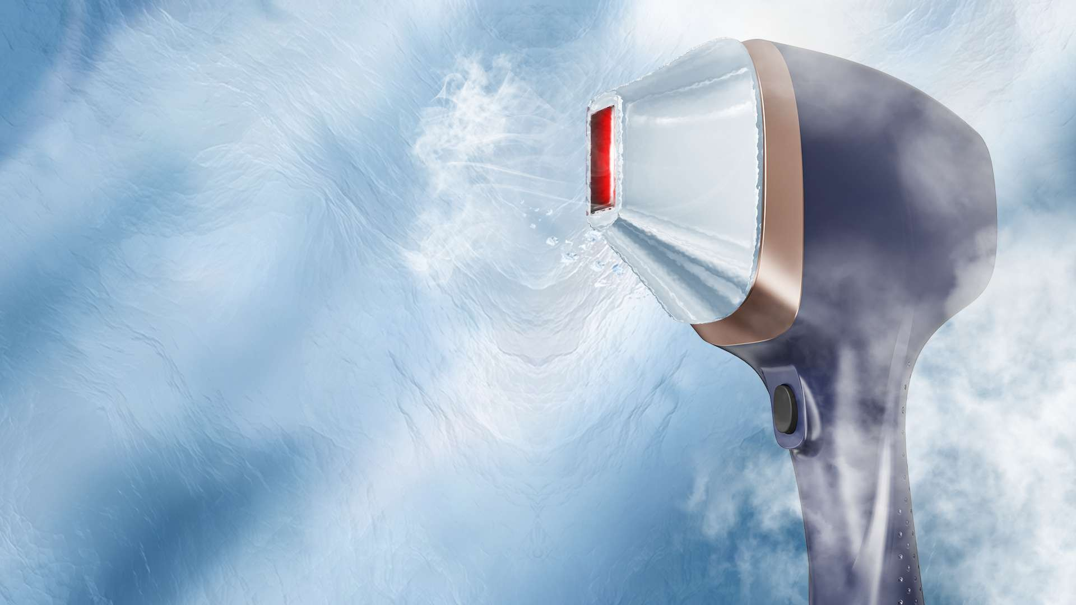






























































Cooling Technology
Handpieces With 360° Contact Cooling
Strong Cooling,Painless Treatment.
With strong TEC cooling technology, No pain during treatment, give patient a more comfortable treatment, and get a better treatment results.

Slide 15
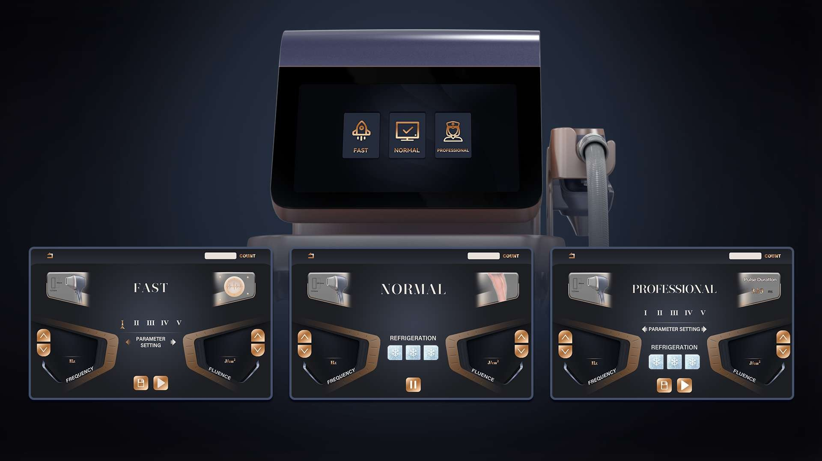






UI lnterface

Slide 16
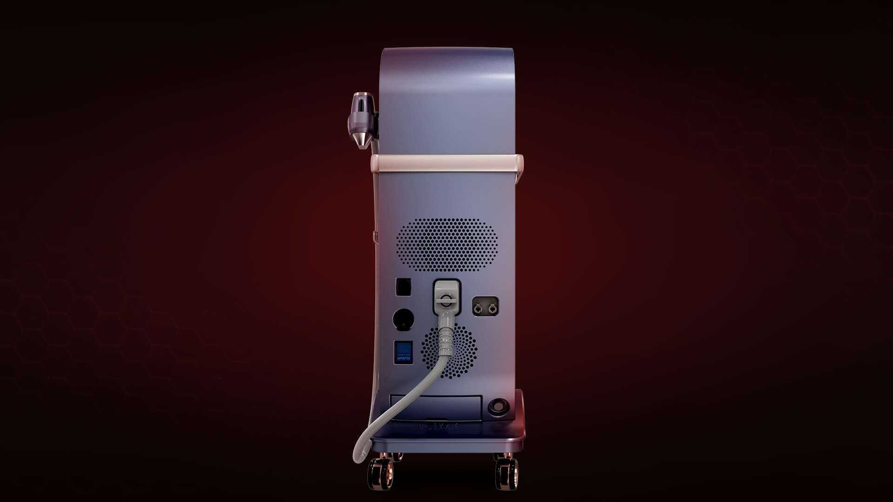






Product Display
Back View
Handpiece Connector
Foot Switch
Overflow
220V/110V Aviation Plug
Water Input
Water Output
Air Switch
Water Filter Box

Slide 17
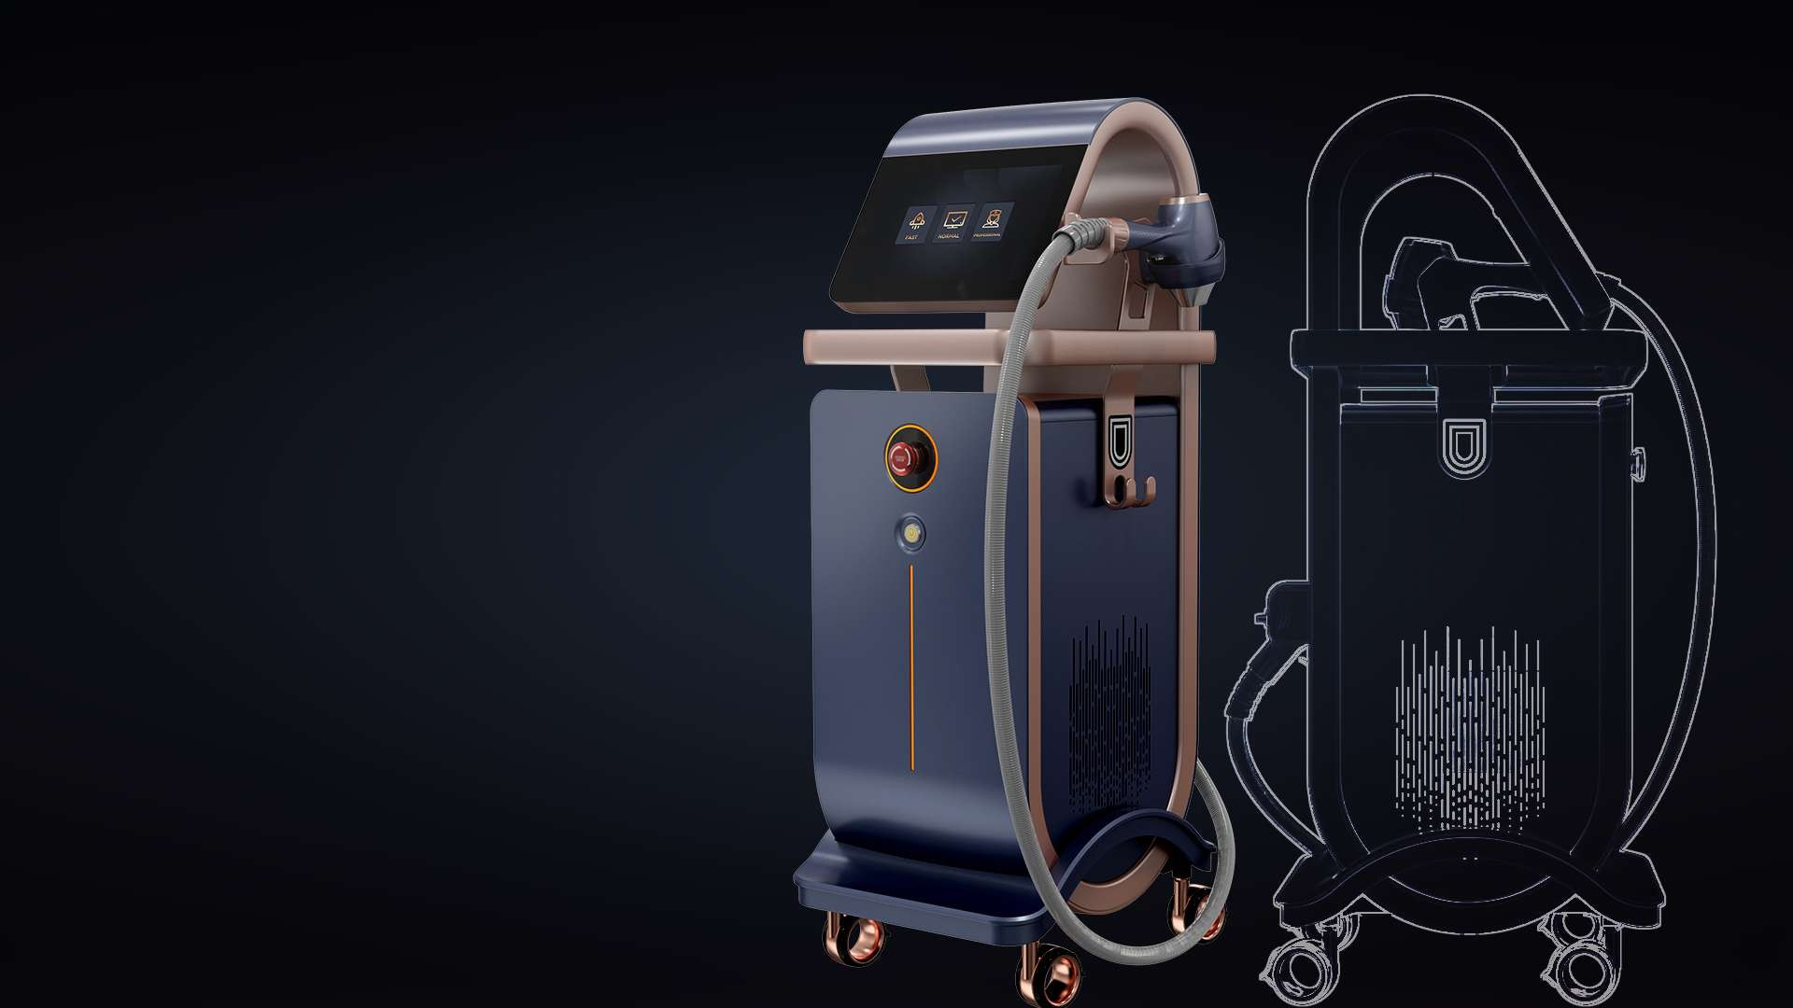









Specifications
Wave Length: | 755nm+808nm+1064
Fluence: | 5~80J/cm²
Pulse Width: | 5-100ms
Spot Size: | 12.5*14.5mm 13.5*28.5mm 13.5*38.5mm Round 8.25mm
Frequency: | 1~10Hz
Handle Power: | 1800W
Machine Power: | 4500W
Cooling: | TEC, air cooling + water cooling + semiconductor cooling
Handpiece Cooling: | -16℃
Display： | 12 Inch multi color touch screen

Slide 18











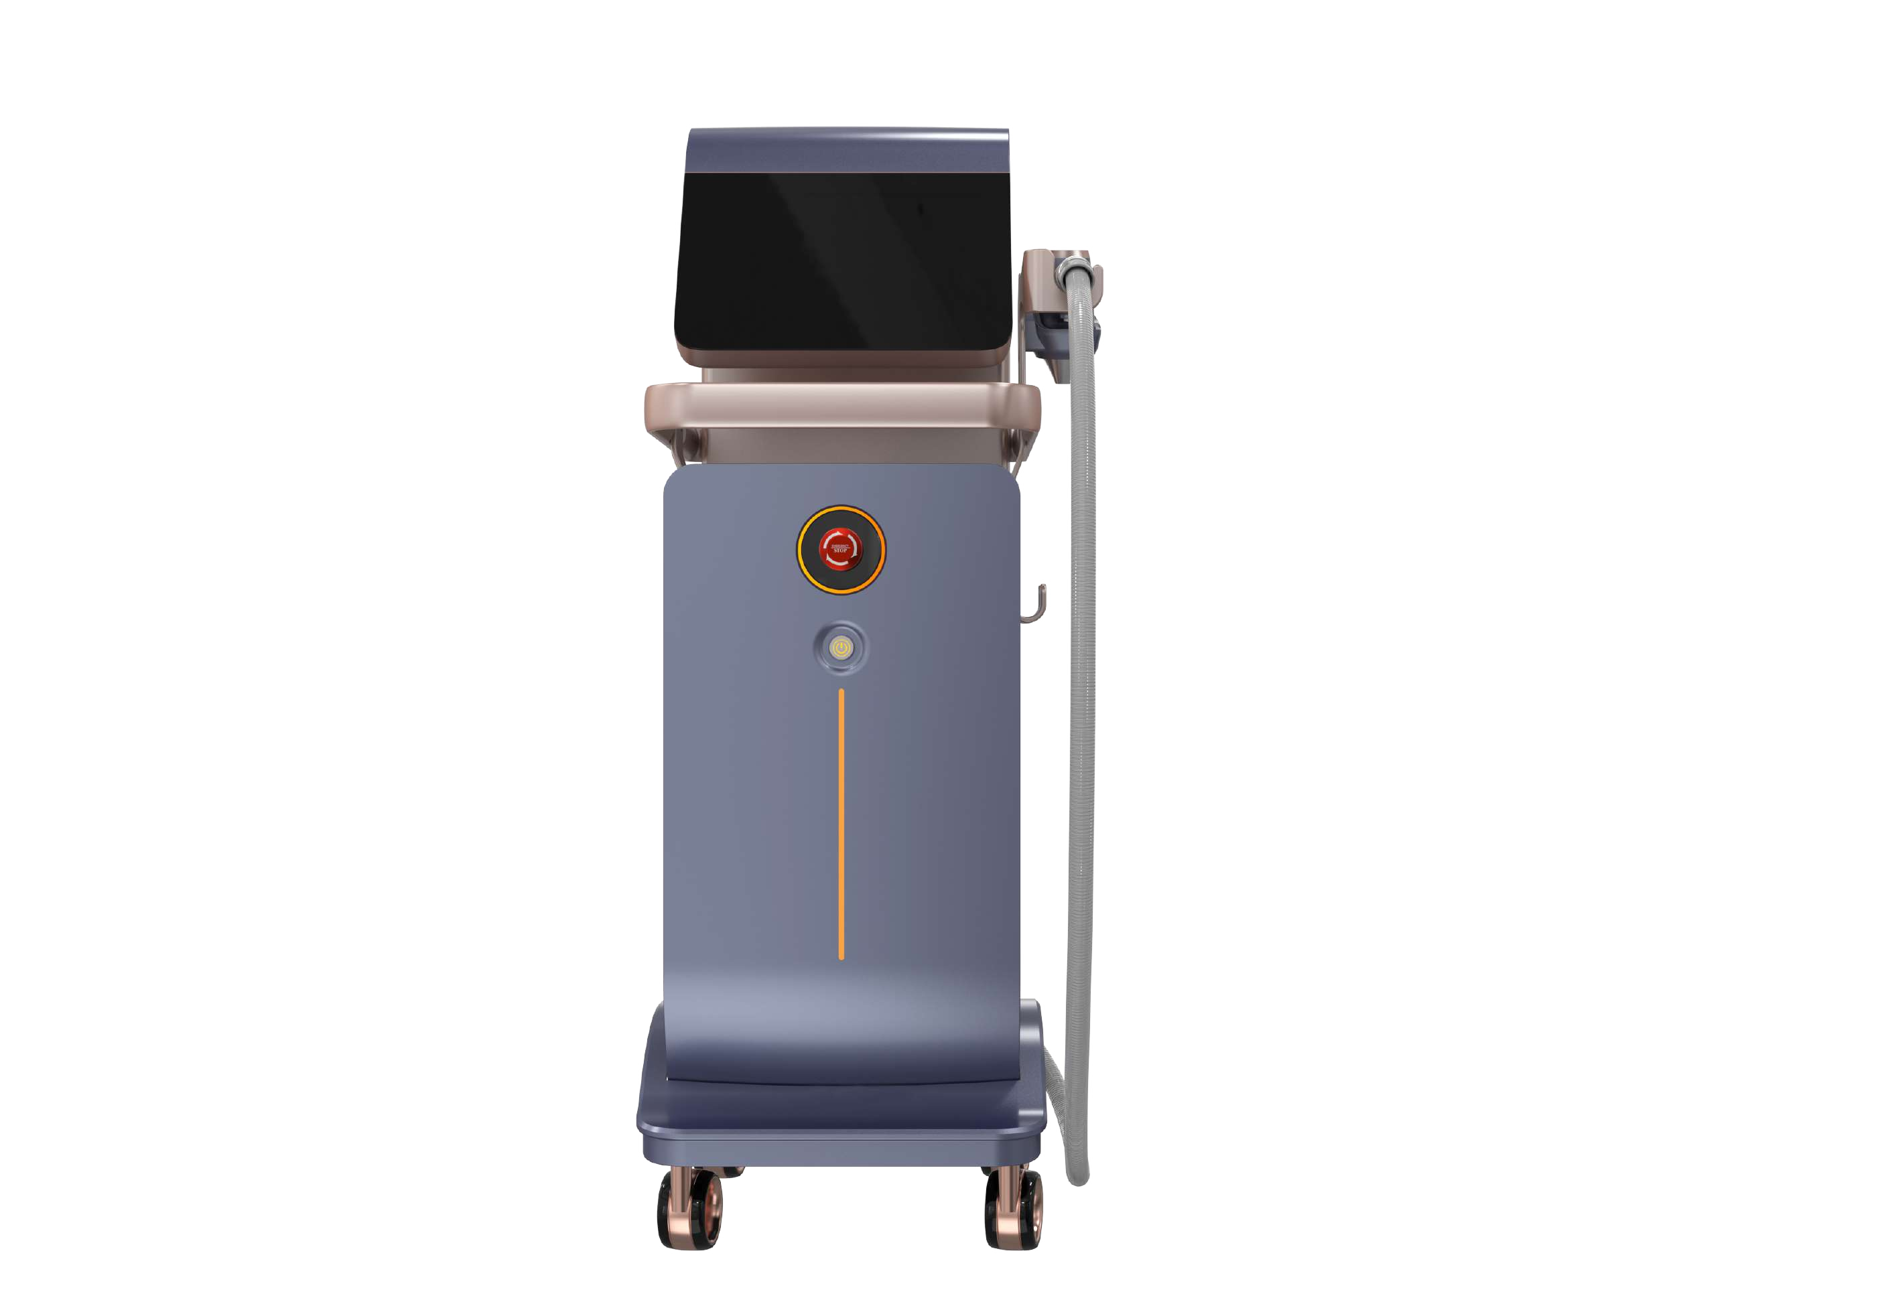
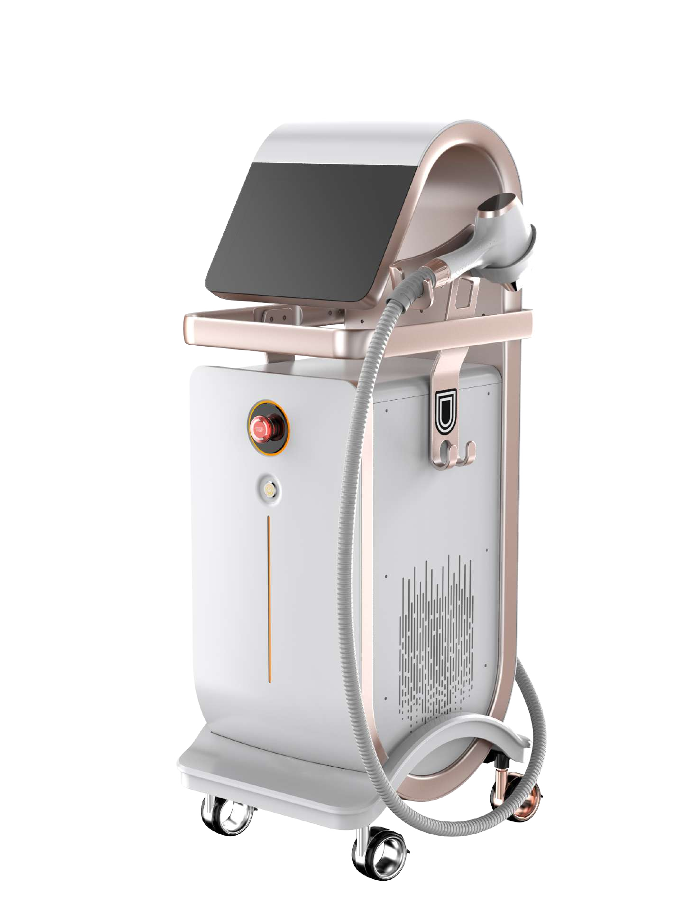
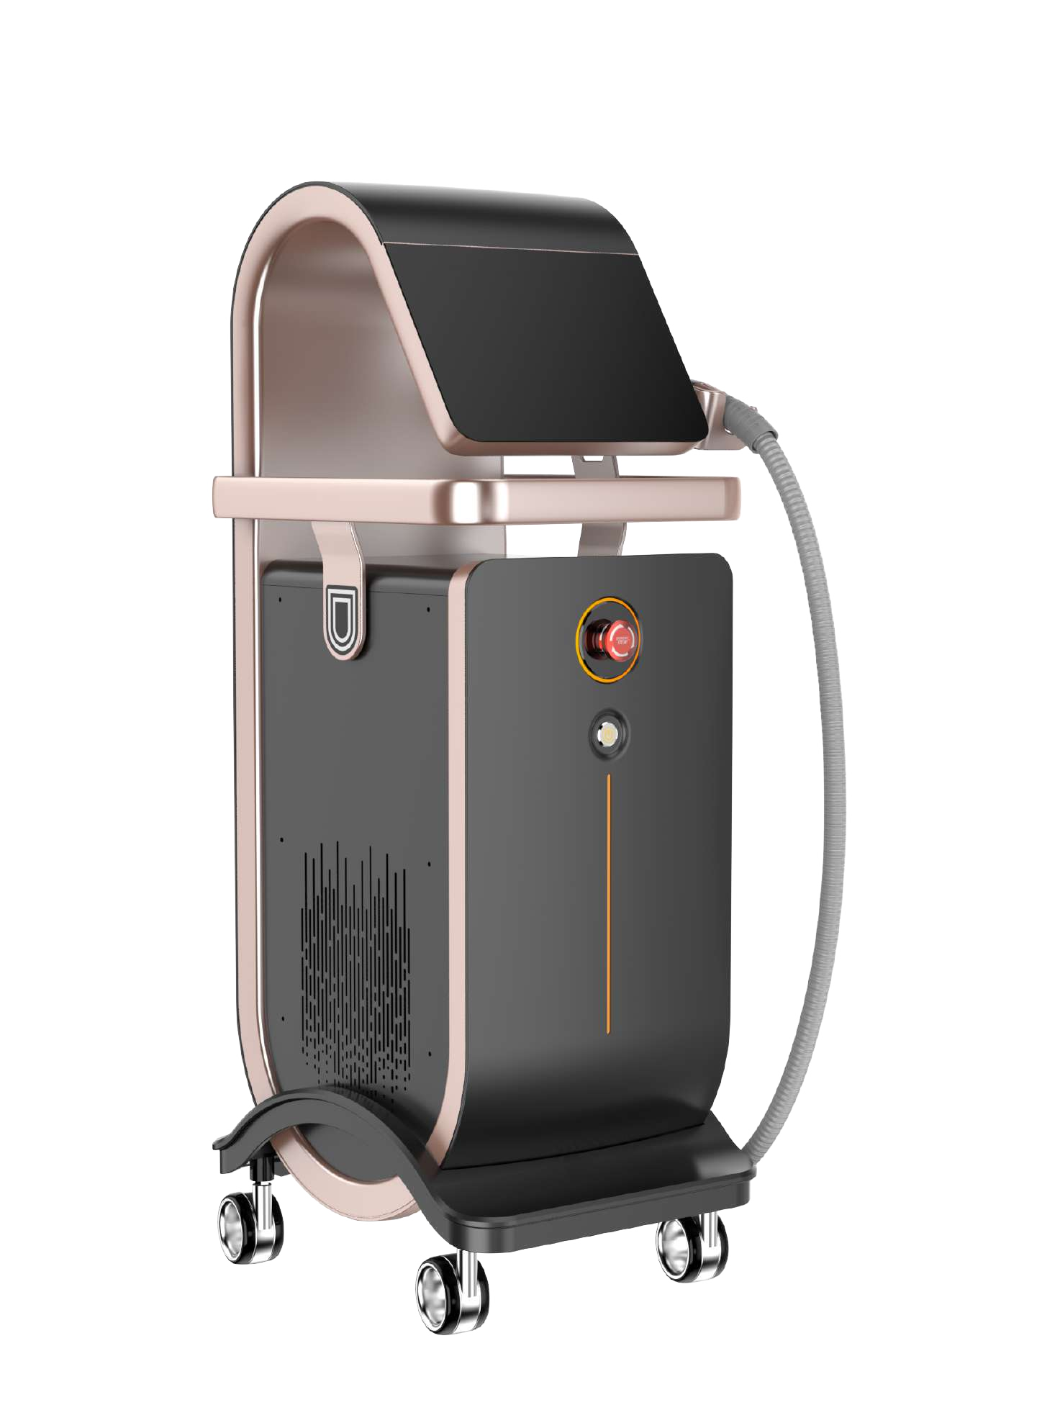



Different Machine Color Available

Slide 19
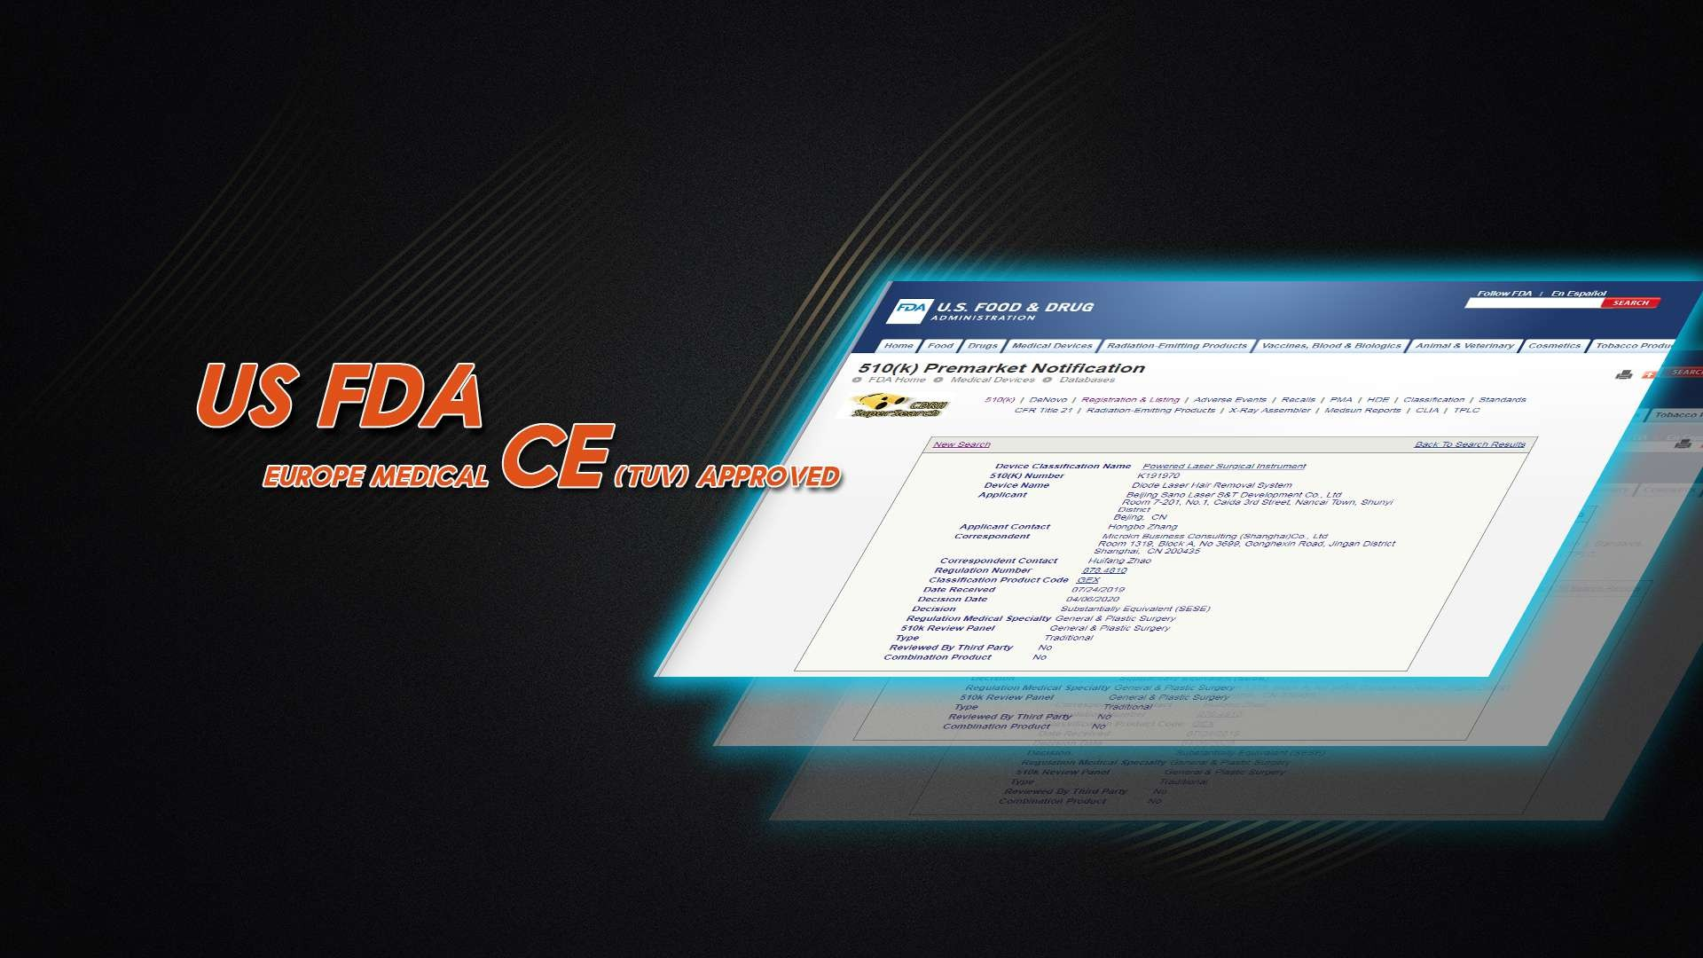




Certificate

Slide 20
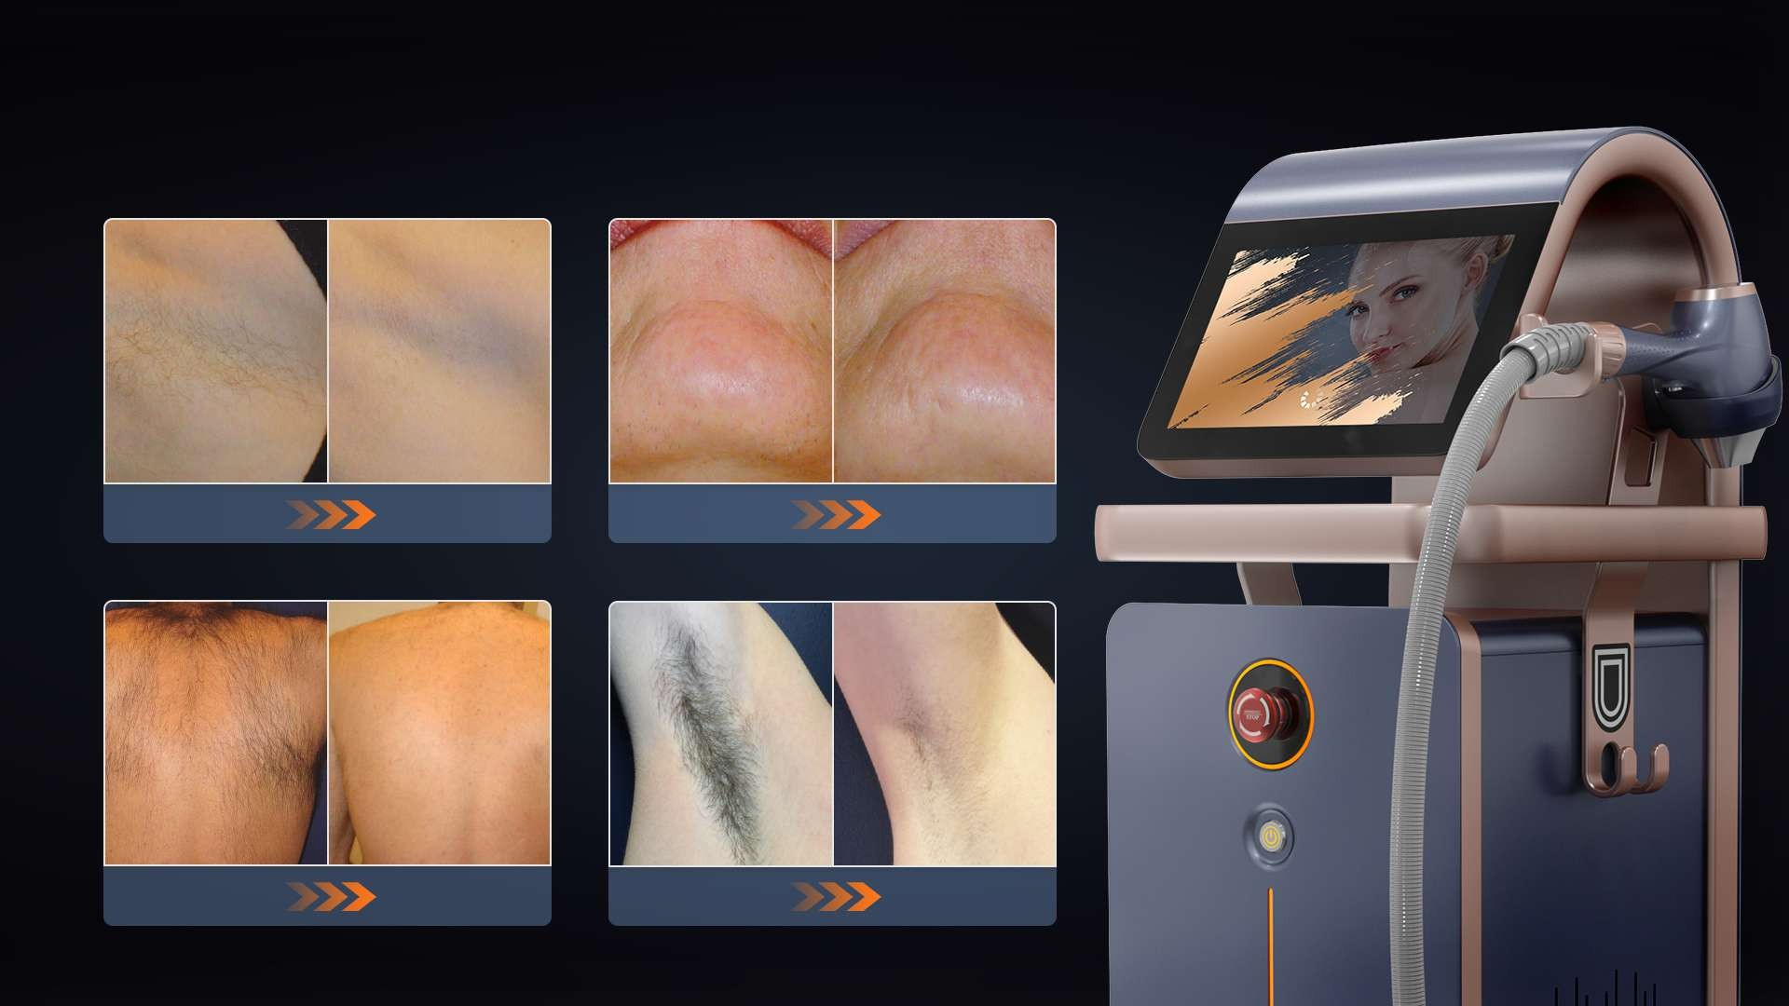









Before & After
Before
After
Before
After
Before
After
Before
After

