Slide 1

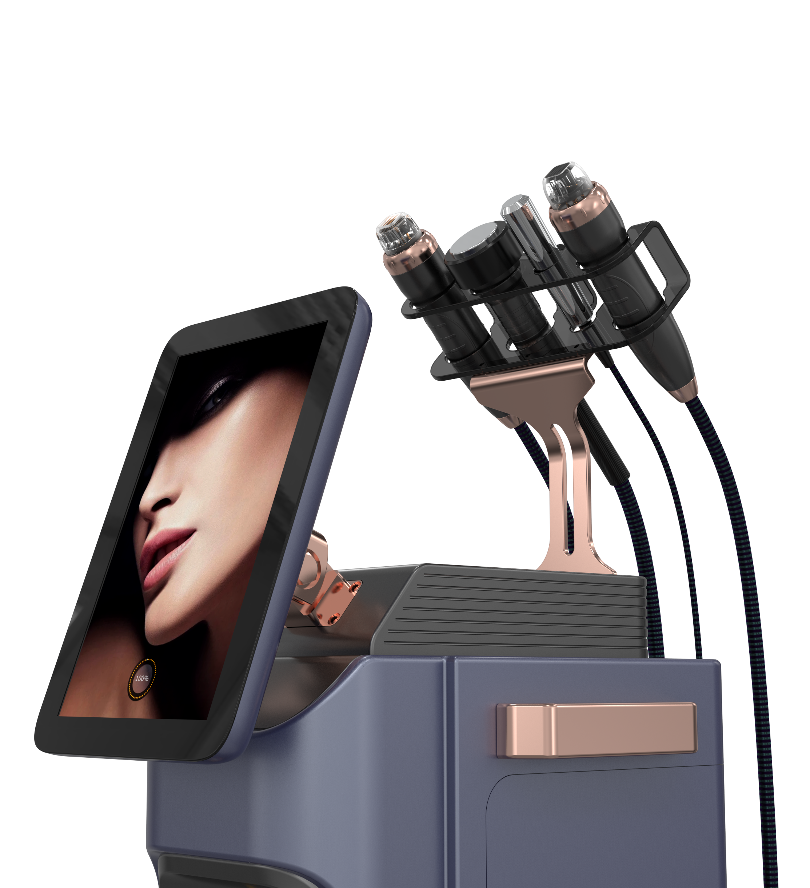

PINXEL-V
NEWEST GENERAT | ONMI CRONEEDL ING RF

Slide 2
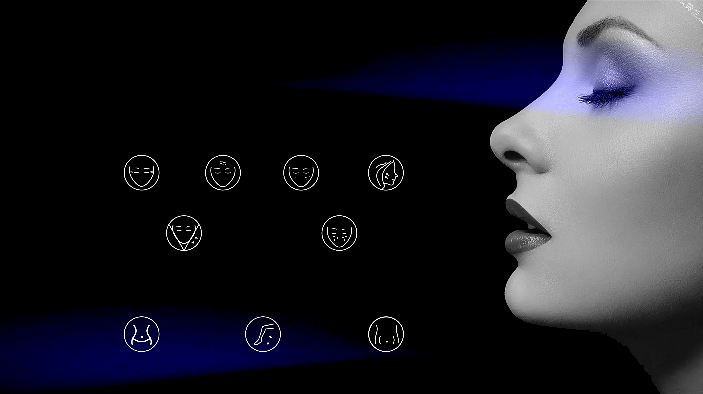
Application
One device. All skin types. All skin resurfacing
Face
Fine lines
Deep Wrinkles
Acne scars
Tightening
Skin reconstruction
Appearance of large pores
Body
Stretch Marks
Scars from injury or surgery
Fine lines

Slide 3
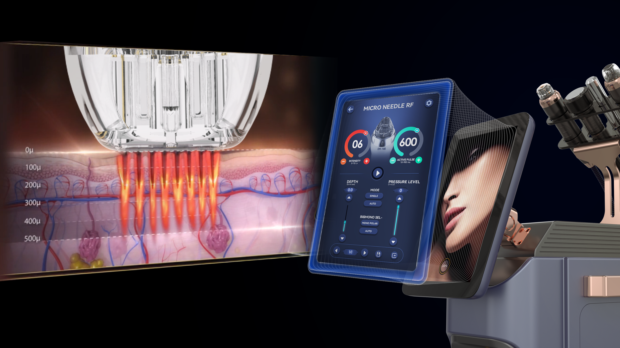
Working Mechanism
Collagen induction therapy is one of the safest skin resurfacing treatment available. Also known as skin neeling. It involves the use of a single use needle gently penetrating into the skin needling stimulates the release of growth factors that build up natural collagen and elastin in the area that’s being treated.
This is an excellent method of collagen insuction as the epidermis and melanocytes in the deep layer of the skin are not damaged so there is no possibility of pose inflammatory hyper pigmentation. Unlike lasers or dermabrasion, RF powered microneedling can be use on most skin types and colour, and even sensitive areas close to the eyes. It is a traget focused treatment and will not touch the surrounding skin with fast recovery time.

Slide 4
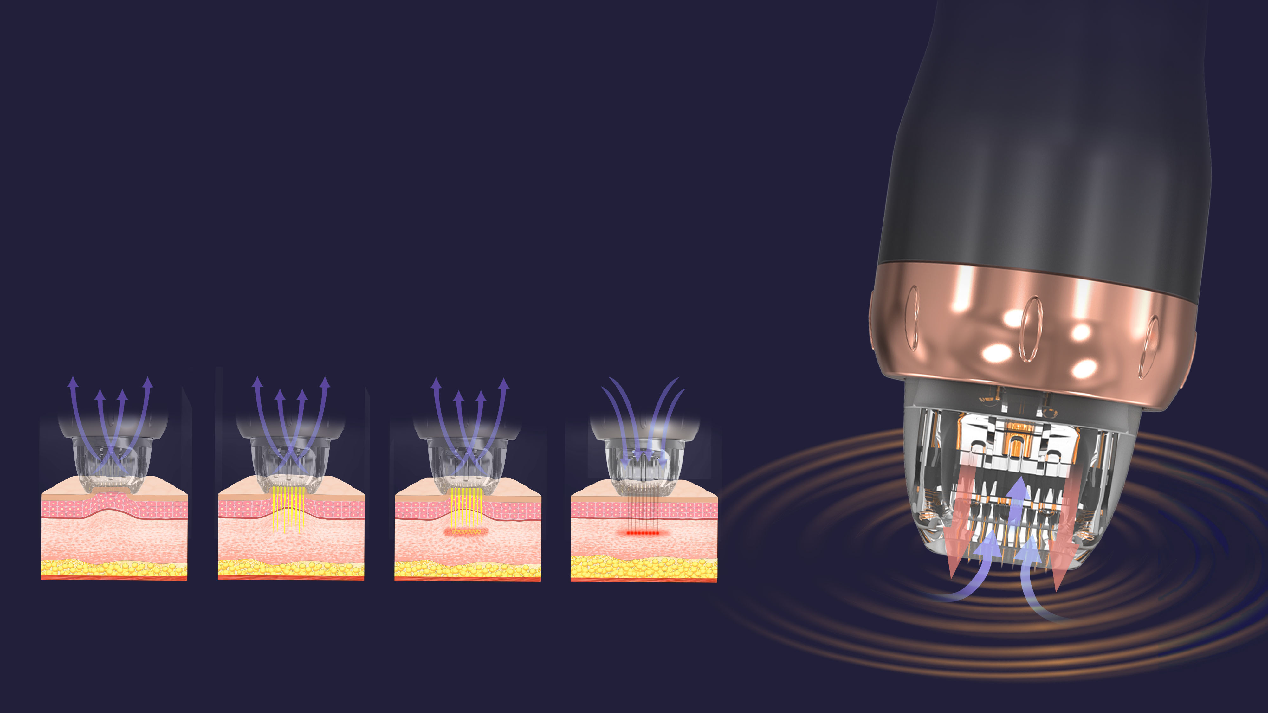
Advantage- With Vacuum
Pinxel-V update RF microneedling with vacuum, push the topical deeper with one kind dual air chamber design, air is captured through enhanced tissue engagement, microneedles creat channels and RF energy is delivered, as neeles retract, air is released towards the skin, driving topicals deeper into the dermis, resulting in enhanced topical penetration up to 67% with the M and F Type needles.
Pinxel-V takes RF microneedling to new levels. The versatility this system provides allows you to customize treatments based on your patients’ specific needs – all skin types, anywhere on the body, any time of the year.
Auto Capture Skin
Creat channels
Release vacuum & needle
Finished

Slide 5
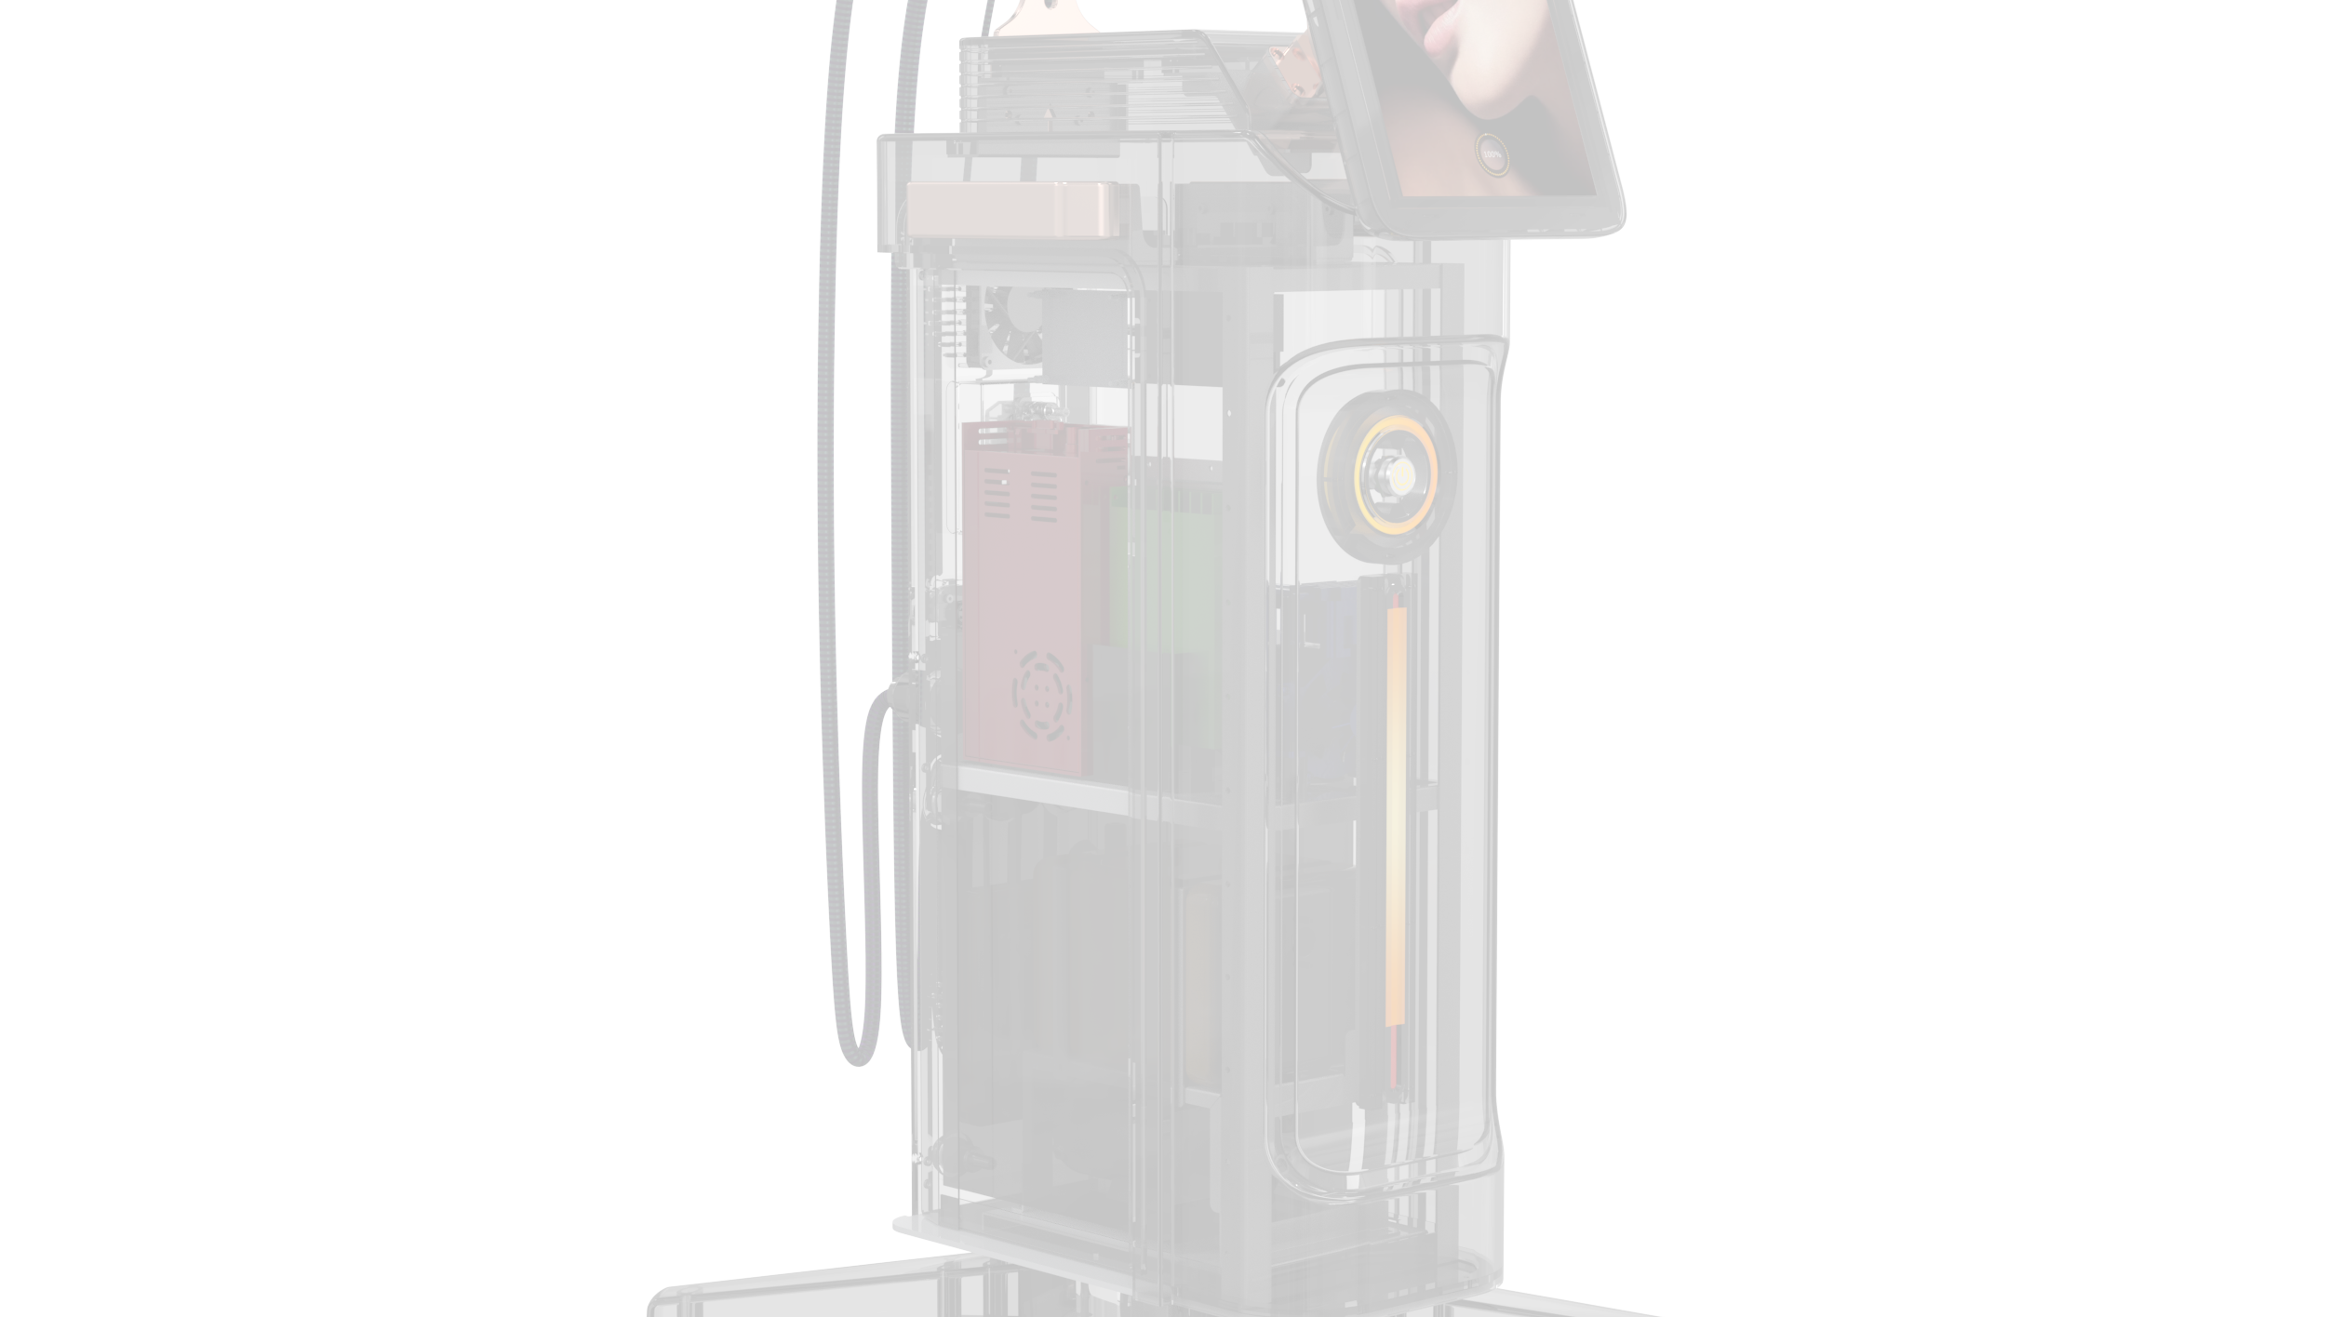
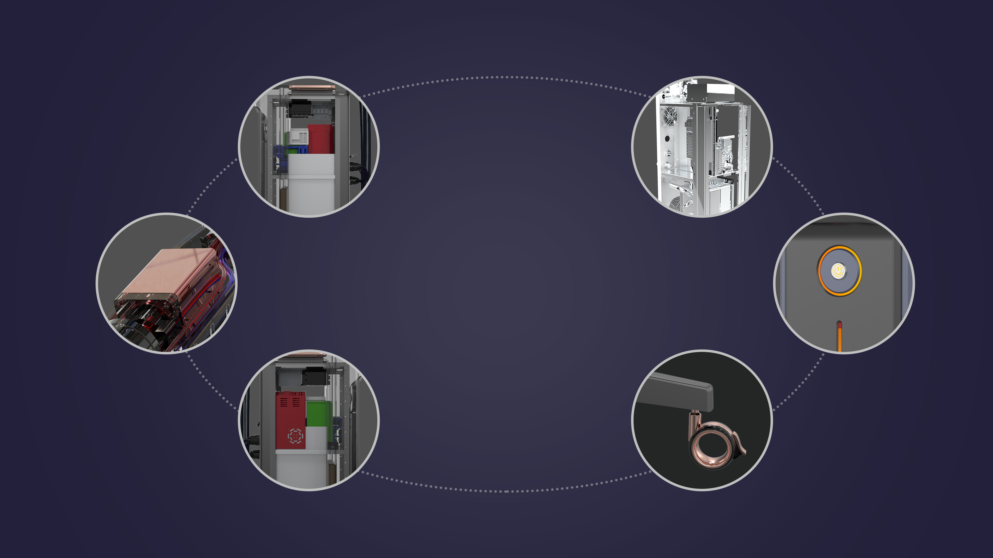
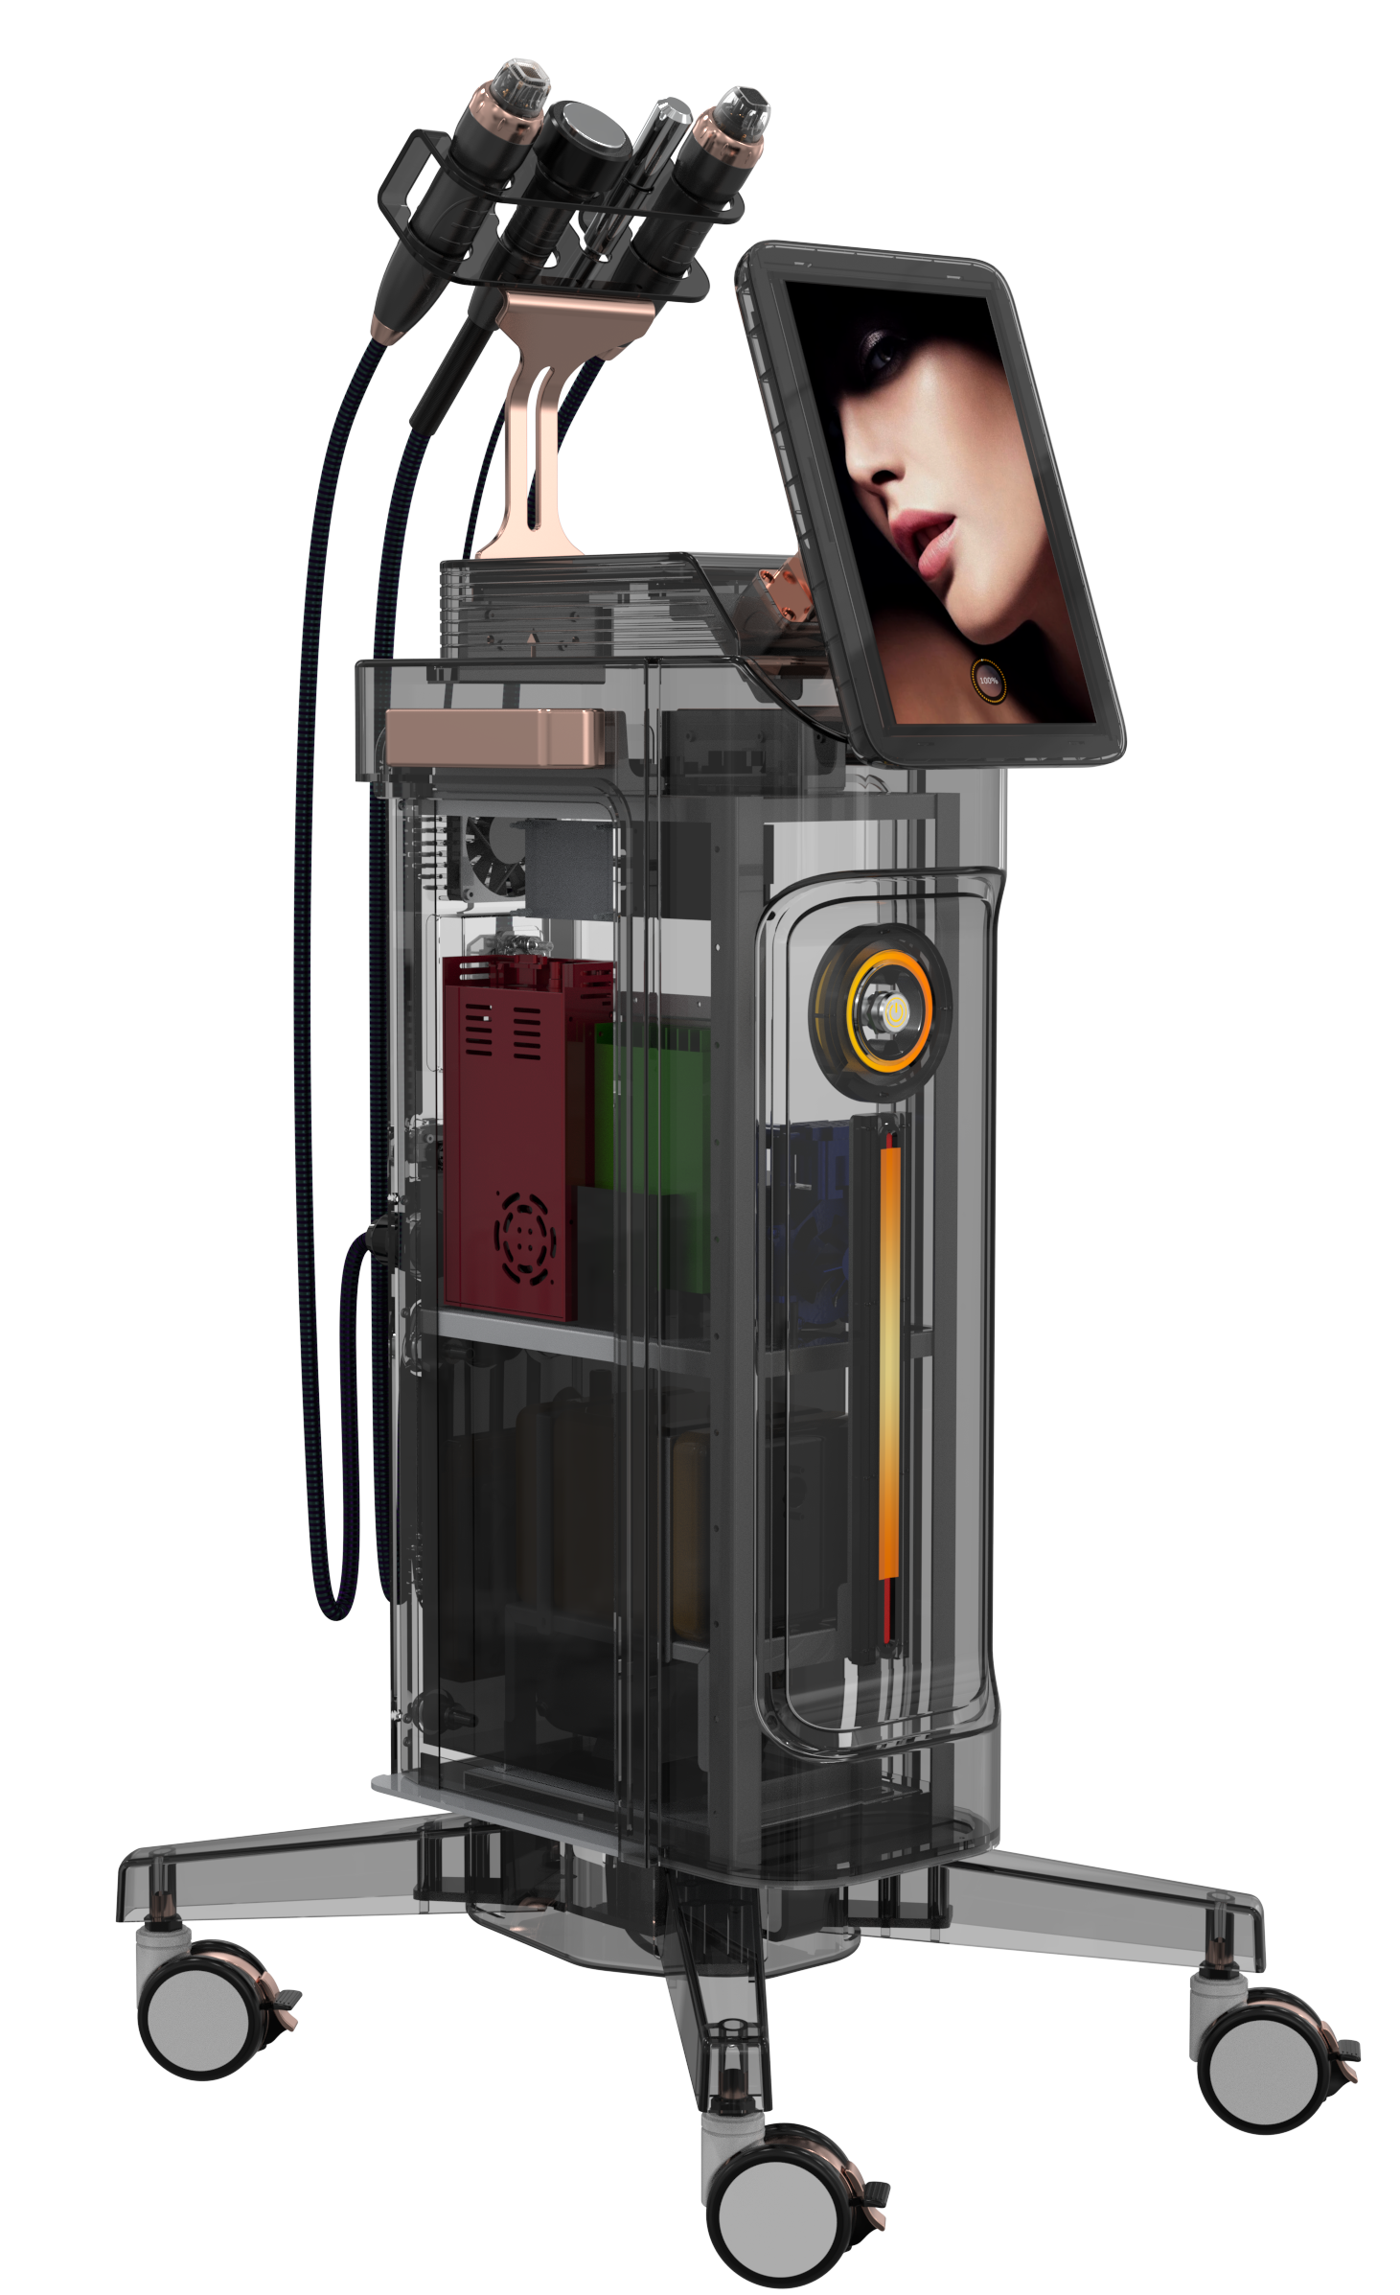
Introduction
2MHz RF Frequency
Metal Frame
Stepping Motor Driving
Button Switch
Modular component
360-degree silent wheel

Slide 6
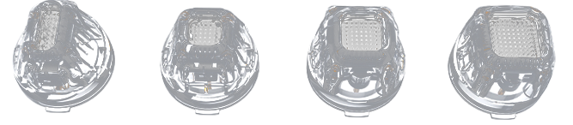
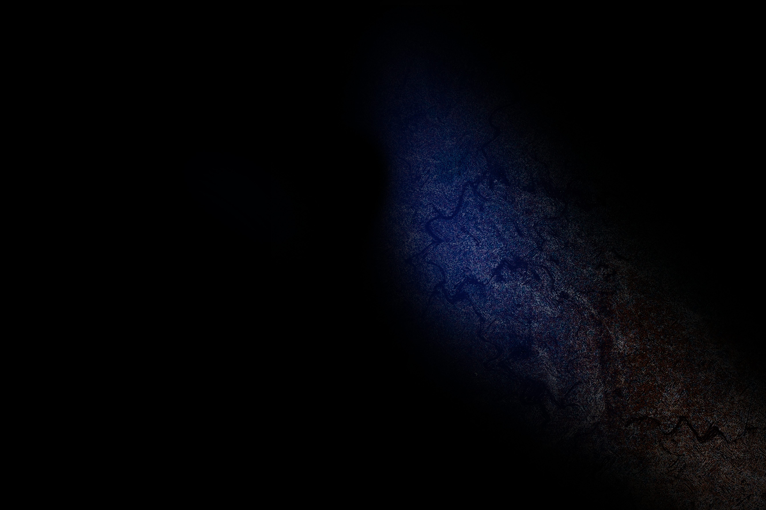
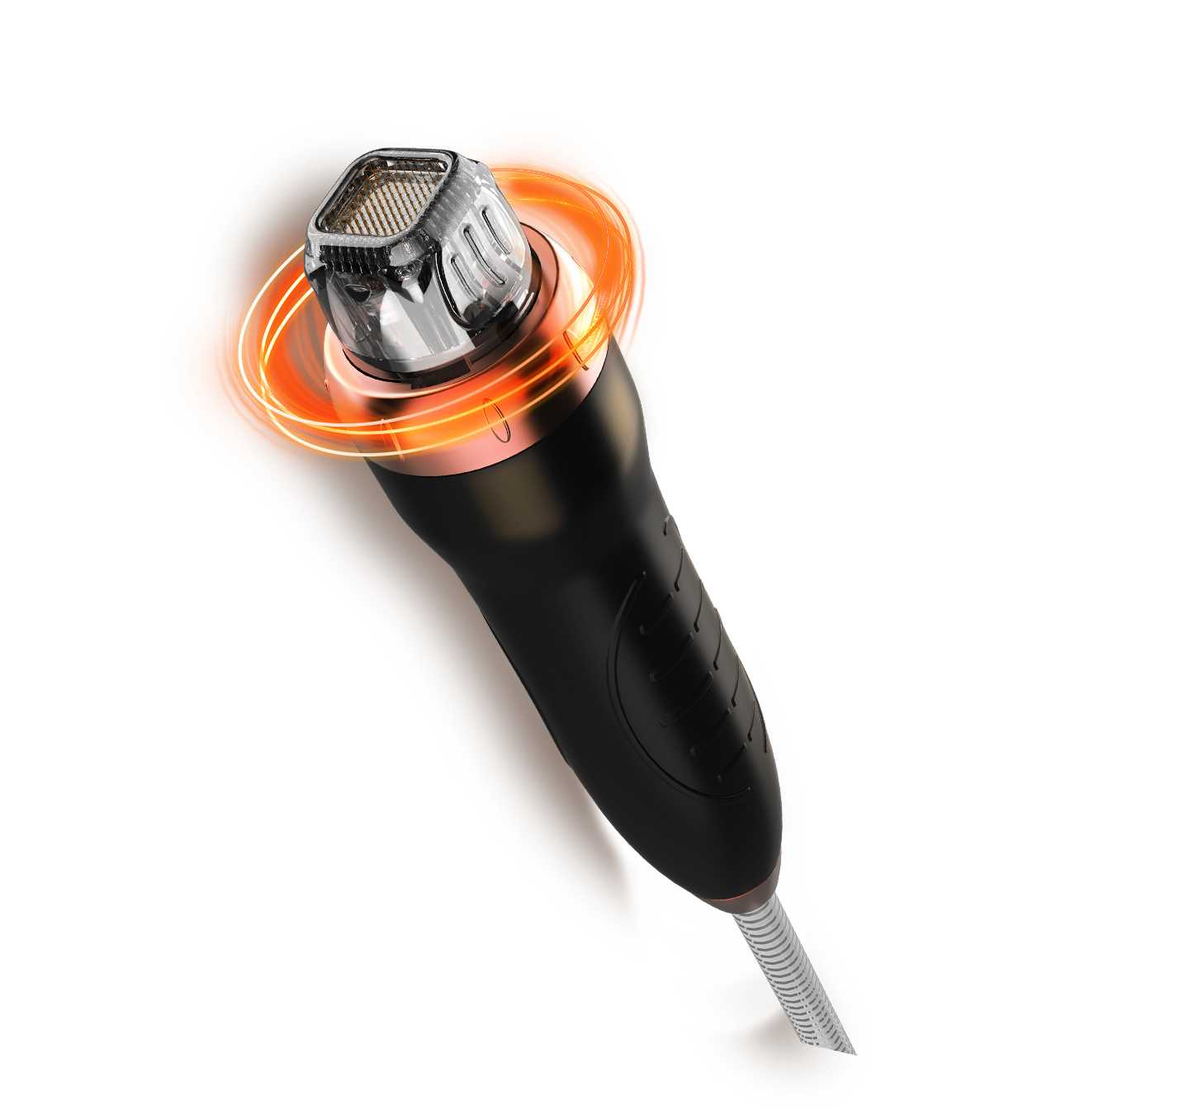
Advantage- With Vacuum
- MICRO NEEDLE RF (RF) applicator for procedures requiring ablation and resurfacing of the skin. Add vacuum - suction combined probe for better skin contact, especially around eyes and neck areas.
M-18
M-25
M-49
M-81
M-18
Stepping Motor Type
M-25
Neele Depth Control
Stepping Motor Type, different to existing solenoid type, the needle inserts to the skin smoothly with no shock, and causes no bleeding and no pain after the procedure
5-4.0mm [0.2mm Step]
Operate epidermis layer and dermis layer by controlling the needle depth in unit of 0.2mm.
M-49
Gold Plating
M-81
Seafty Needle System/Needle Thickness: 0.2mm
Needle is durable and also have high Biocompatibility by applying Glold Plating. Patient with Metal allergy could also use it with not conceming Contact Dermatitis.
Sterilized disposable needle tip
operator can easily notice the applying RF energy from LED light.
The needle structure is easy to penetrate the skin with mininum resistance.

Slide 7

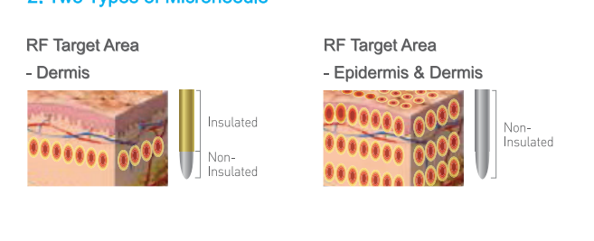
Proveide Insulated & Non Insulated
Insulated
Less painful
Treat Dermis only
Less redness, easy to recovery
Less result
▘Suitable for person who need go to work everyday
Non-insulated
Painful
Treat Dermis and Epidermis
More recovery time, easy scab
Better result
▘Suitable for person who want good result

Slide 8
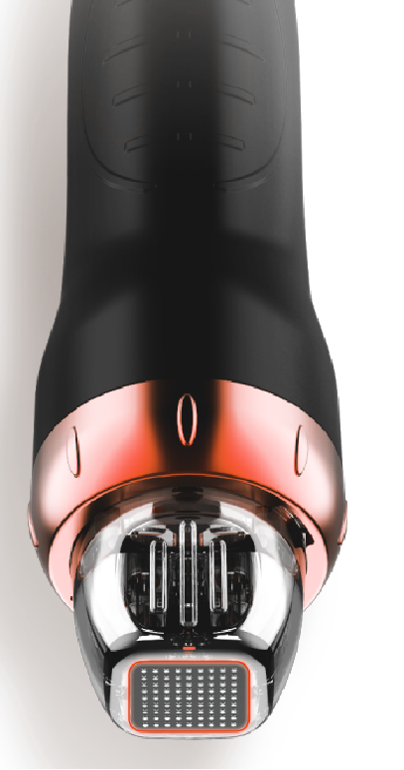
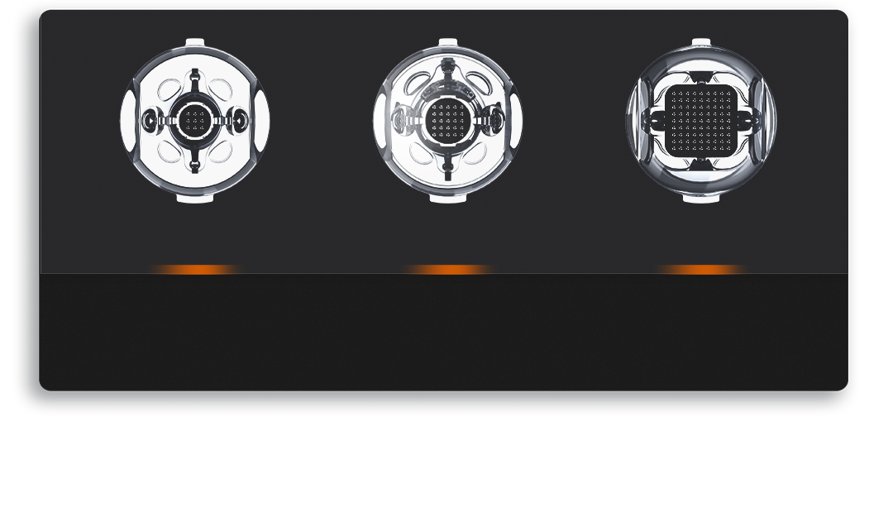
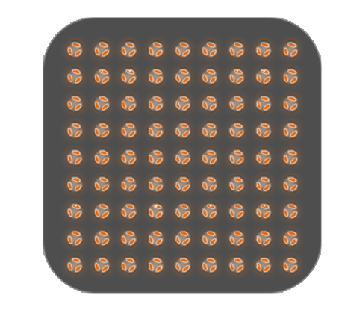
PINXEL-V -Fractional RF
-- FRACTIONAL RF applicator for non-invasive wrinkle reduction， suit for the patients fear of needle, recovery soon
F-3*3
F-5*5
F-9*9
▘Eyes
▘Nose Area
▘Face Area
▘Body Area

Slide 9

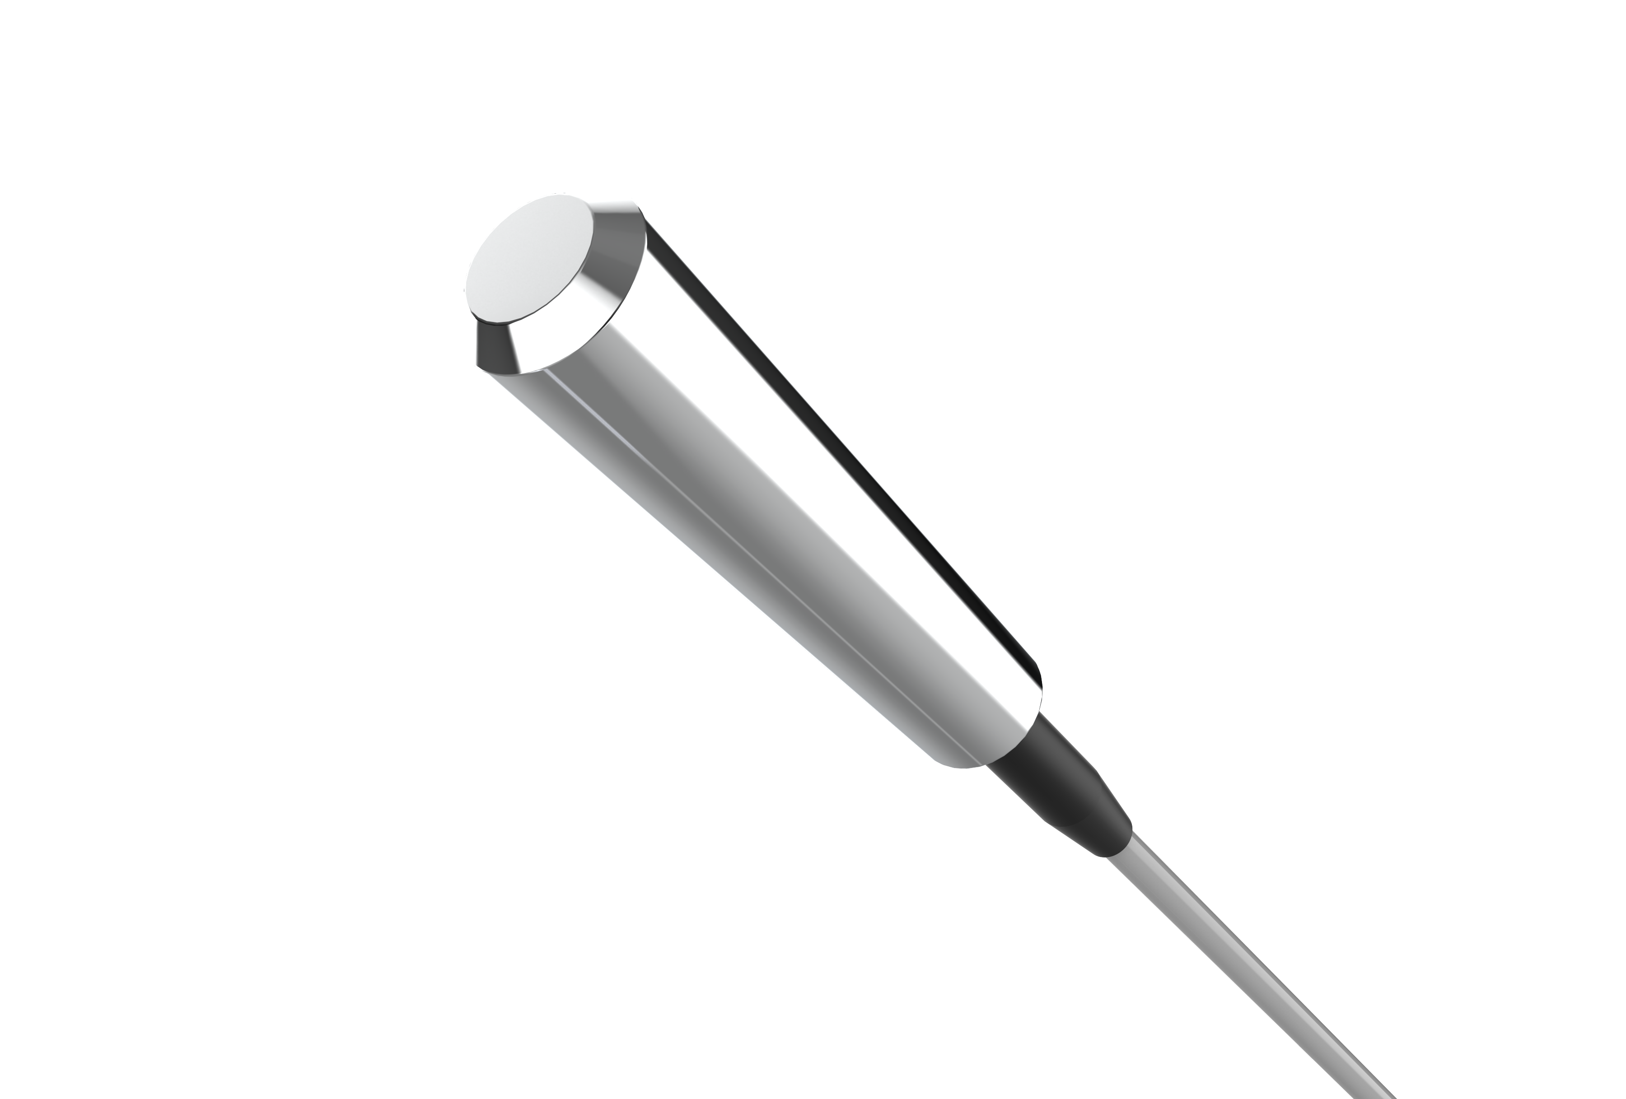
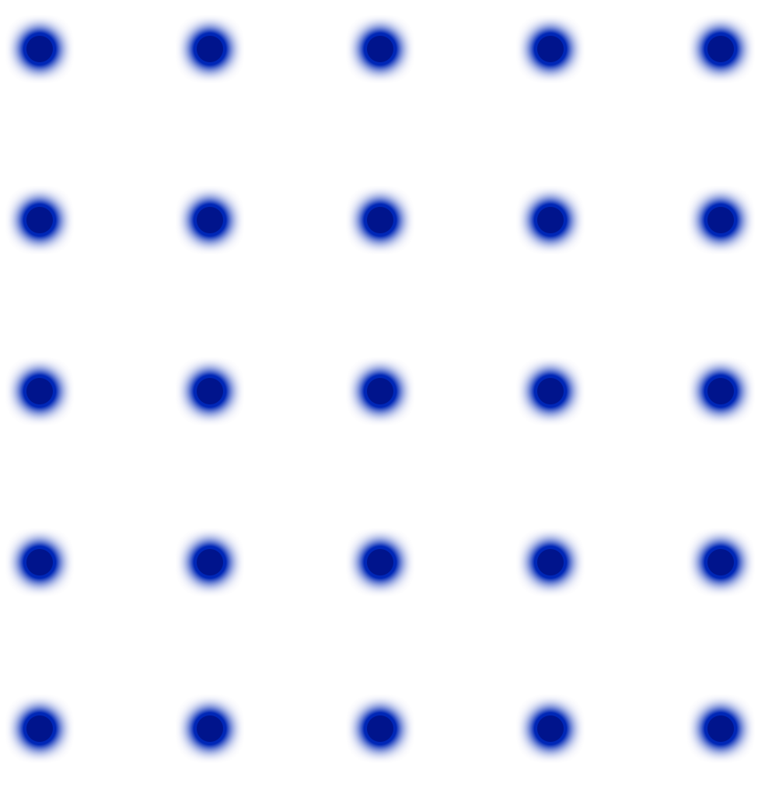
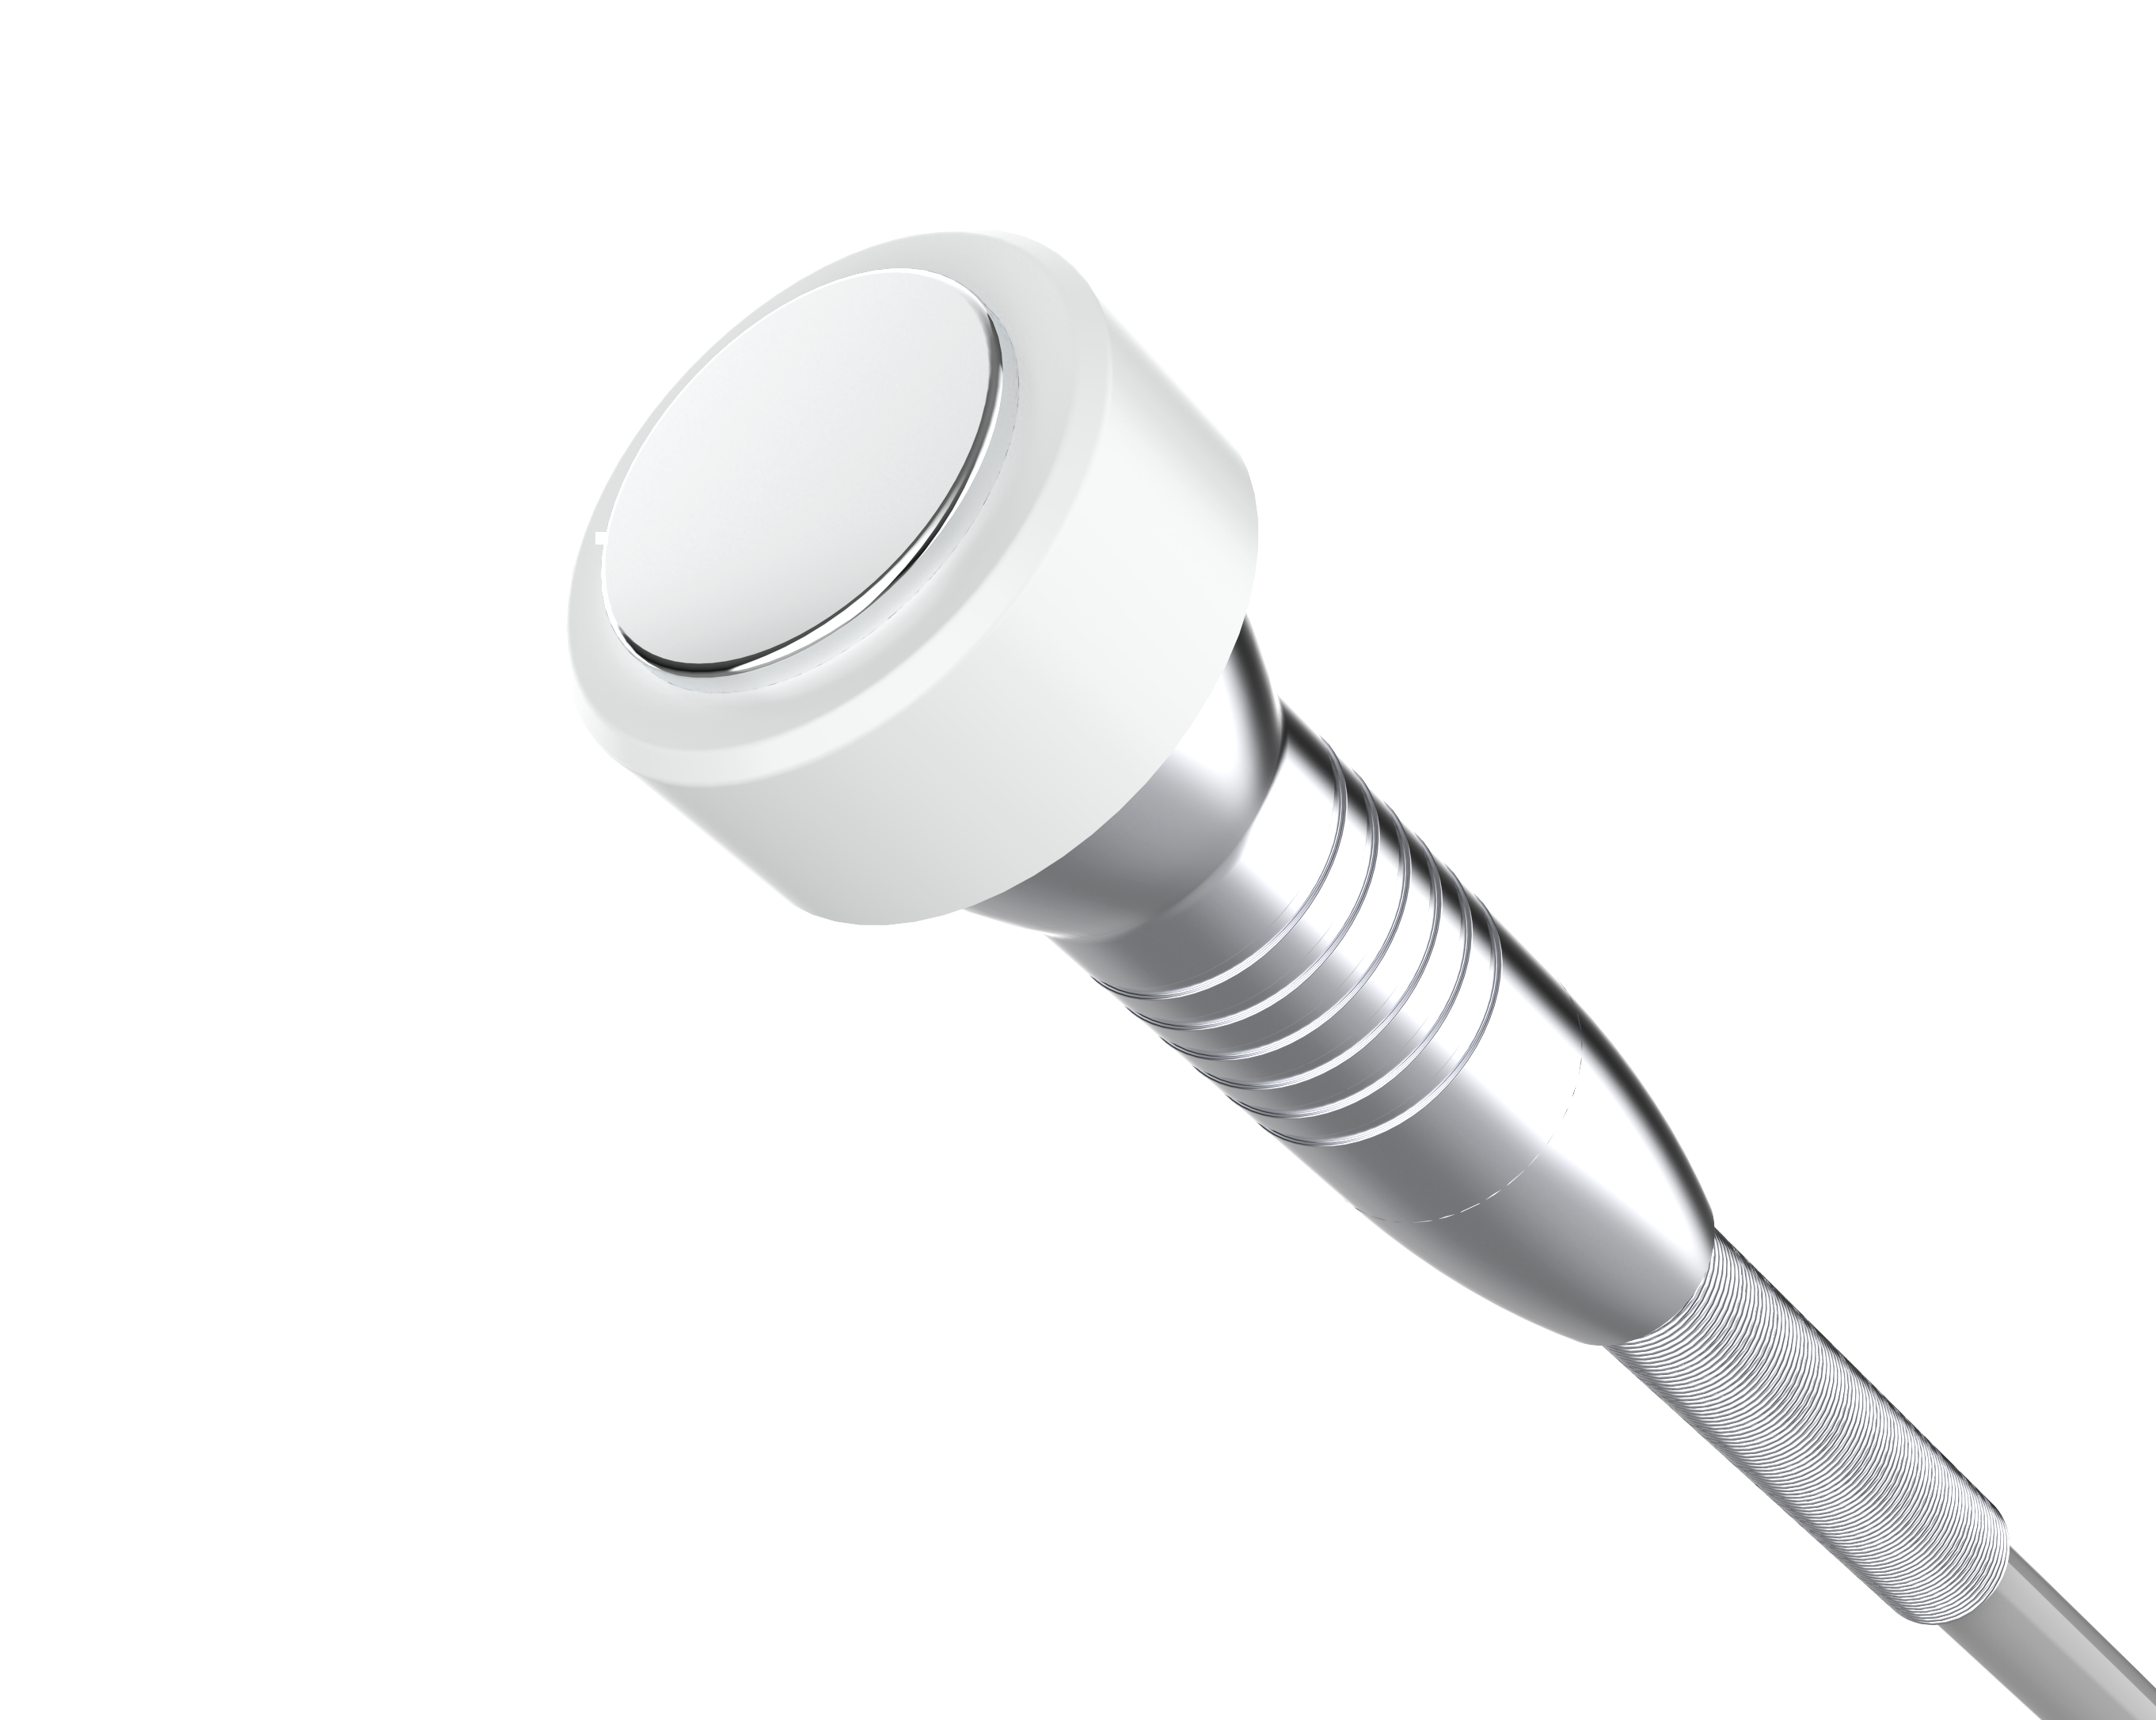
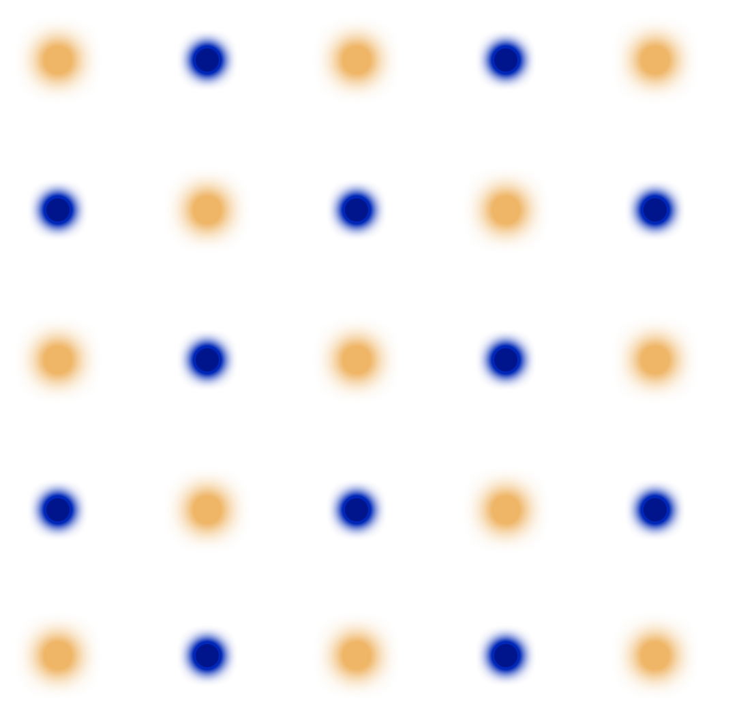
PINXEL-V -Fractional RF
-- Negtive polar (MONO/BI POLAR）
Body: Deeper
Negtive Handle: Together with
MONO polar, energy transfer Deeper
Under Bipolar
50% percent needle is positive and the other 50% is negative polar. this make the energy only works on depth of the needle. This mode is more suitable for face treatment.
Under the Mono mode
all the needles on the tip is positive polar. The customer need to hold the negative polar in hand during the treatment. The RF energy can go to more deeper to skin than Bipolar mode. So it's more suitable for body treatment.
Cooling handle: Max Reduce Pain
Face ：Evenly
▘negative pole
▘positive electrode

Slide 10
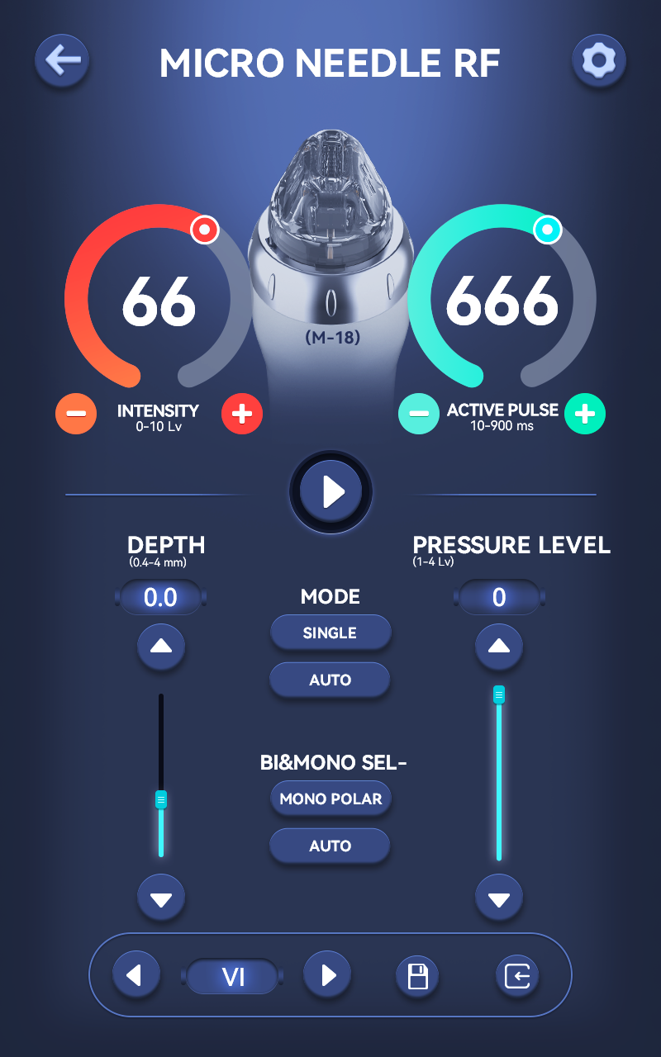
UI Interface
10.4 inch Full-size touch operation , Sliding menus, easy operation.
Return
M-18 Needle
Energy Level 1-10
Actibe pulse 10-900
Working/Stop
Wording Mode
Pressure level
Needle deepth
Negtive polar (MONO/BI POLAR)
Preservation

Slide 11
PINXEL-Vpro
Energy Calibration
Energy calibration means evaluating a relationship between the energy of the emitted particle and the channel number of the peak. Once the energy calibration is known, it is easy to find the energy of unknown source.

Slide 12
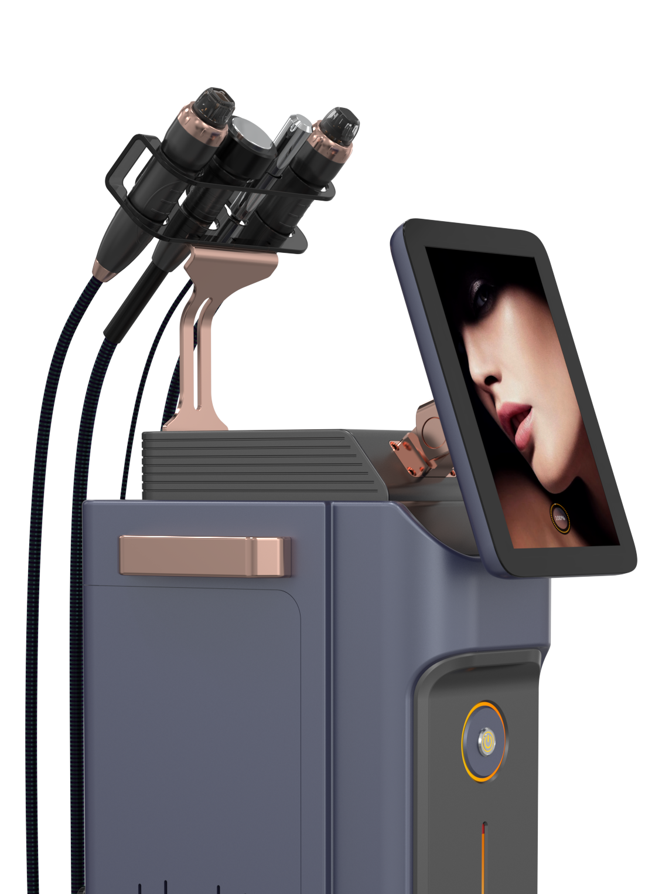
Product | PINXEL-V and PINXEL-Vpro
Power | max 50 watts
Handle | Fractional RF handle Micro Needle RF handle
Frequency | 2MHz
Energy | 1-10 Level
Pulse Duration | 10-900ms
Needle Deepths | 0.4-4mm adjustable
Pressure Level | 1-4
Working mode | SINGLE/AUTO
Mode | MONO & BIPOLAR
Cooling | 1-3 Level
Tips | Insulated & Non-insulated
Invasive Tips | M-18, M-25, M-49, M-81
Non invasive Tips | F-3*3 , F-5*5, F-9*9

Slide 13
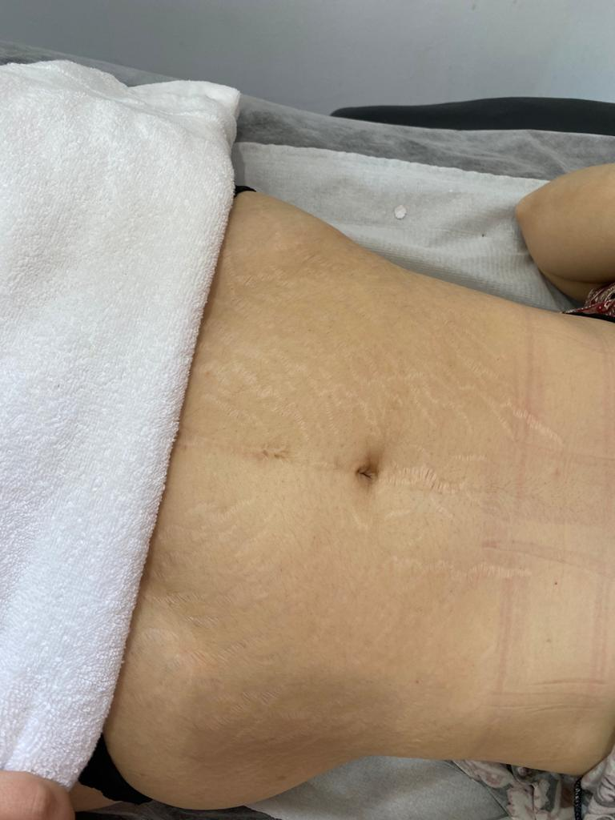
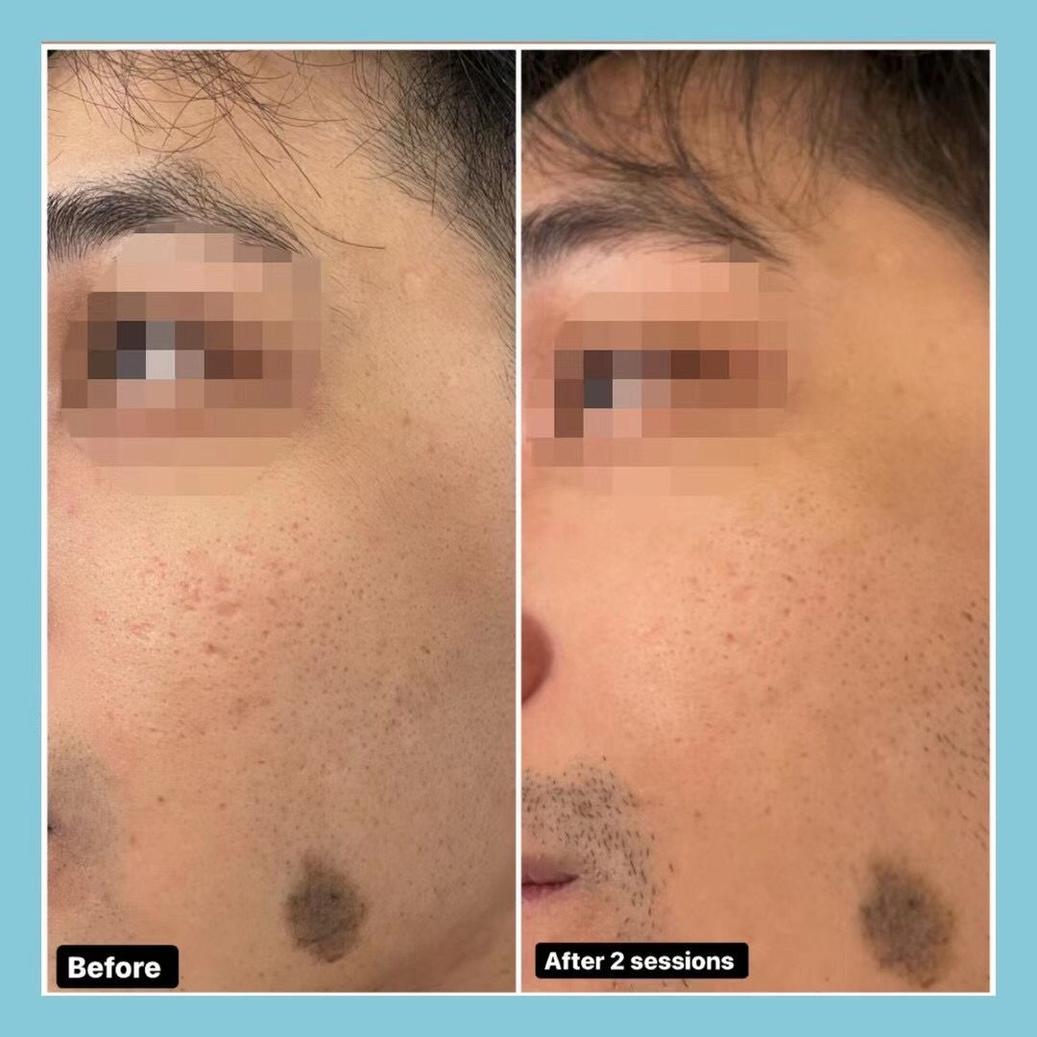
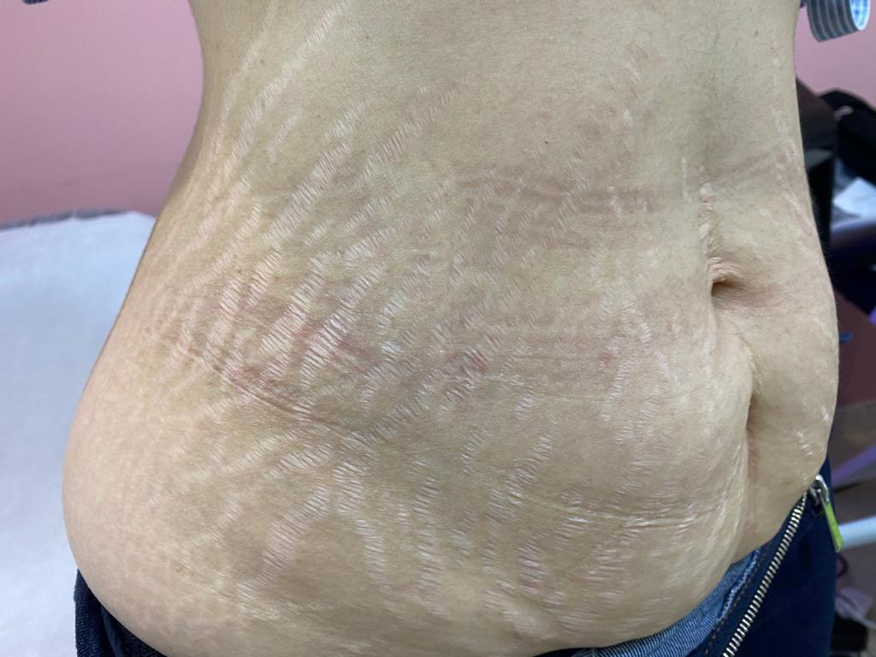
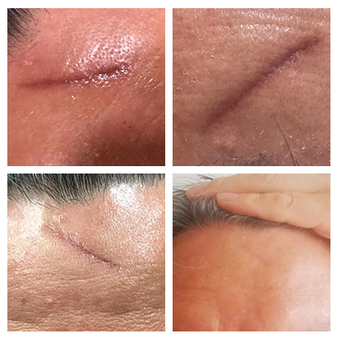
Before & After
After
10.4 inch Full-size touch operation , Sliding menus, easy operation.
Before
After
25 tips non insulated
Level 4
I.0 mm tip
140 ms
2 pass
3 weeks delay
3 treatment times
Before
Before
After
25 tips non insulated
Level 4
I.0 mm tip
140 ms
2 pass
3 weeks delay
3 treatment times
25 tips non insulated
Level 4
I.0 mm tip
140 ms
2 pass
3 weeks delay
3 treatment times

